Slide 1

Unlocking Local Energy Markets
Rachel Bray & Bridget Woodman

Slide 2


The Cornwall LEM
The Cornwall Local Energy Market (LEM) project is a £19m three-year trial jointly funded through the European Regional Development Fund and Centrica.
The project is led by Centrica in association with project partners Western Power Distribution, National Grid, the University of Exeter and Imperial College.
Our remit is to assess the LEM’s performance in the current policy and regulatory framework and to suggest changes to the framework to assist the development of future LEMs in GB.

Slide 3


What are LEMs?
Online marketplace for distributed energy, storage and flexibility providers.
Including non-domestic and domestic participants.
Entering both traditional and new markets.
Collective or individual trading.

Slide 4
What can LEMs do for the system?
National Grid’s costs of balancing the electricity system increased by approx. £250 million, to over £1.1 billion in 2016-17 (Ofgem, 2017).
Help towards decarbonisation targets
need to reduce GHG emissions by at least 80% from 1990 levels by 2050 (Carbon Budget Order, 2016).
A LEM enabled system could have lower carbon intensity and increased energy efficiency through the deployment of small-scale renewable technologies and storage (Mitchell, 2016).
Reduce system costs - Imperial College suggest reduced system costs of between 25% and 40% could be achieved through the deployment of new, cheaper, flexibility sources connected at the distribution level (Shakoor et al., 2017).
In all scenarios, extra flexibility (including storage, interconnection and DSR) is a low regrets investment which reduces estimated total energy system costs by between £1-7 billion per year on average between 2030 and 2050 (NIC, 2018).

Slide 5
What can LEMs do for the system?
Local network balancing - matching generation and supply locally.
Help with congestion issues - through more intelligent management of demand, generation and storage on the networks; including managing load / demand at peak times.
Increase renewable generation opportunities - enabling additional renewable generators to connect to the network in locations which were previously considered to be constrained.
Distributed generation in GB now represents around 30% of total GB installed capacity, at 30,838 MW
(DUKES, 2018)
DNOs have a greater need to forecast and actively manage energy flows across the network (WPD, 2017)

Slide 6
What can LEMs do for consumers?
Choice for sellers – choice in which markets to trade in – traditional markets such as balancing, capacity & wholesale markets; or new markets such as P2P; demand-generation coupling; local partnerships.
Choice for buyers - type and location of generator; who they wish to purchase from; price and time they wish to purchase.
Choice for flexibility – reward for demand turn-up/ demand turn down; generation turn-up/down via real-time pricing signals.
Transparent pricing for buying / selling / flexing – making informed trading choices via the online marketplace.

Slide 7
What can LEMs do for consumers?
Value for generation – realising a better price for small scale generation than via PPA route or FiT.
Consumer involvement - no longer passive recipients; now active participants in the energy system.
More options to participate – LEM platform provides an easy route for participants to aggregate in the delivery of services.
More services – greater choice in respect to the services they could receive from or provide to the system.

Slide 8
What’s going on?
RIIO2 (Ofgem)
Charging Futures (Ofgem/ National Grid)
Key market actors are advancing several interlinked initiatives which could aid LEM development….
However there is no clear direction of travel or timescale from BEIS….
Supplier Hub Model Review
(Ofgem)
Access to Data / Blockchain (Ofgem)
Open Networks Project (ENA)
Creating a risk that outcomes may not complement each other and may be steered to reflect the desires of the incumbent lead partners, rather than the best interests of either the customer or the electricity system.
HHS and smart meter rollout (BEIS/ Ofgem)
Market Rules (Ofgem/ Elexon/ National Grid/ Code Panels)

Slide 9
Open Networks Project
Network operations are critical to determining whether, and how, LEM participants can access new revenue streams and localised markets.
The ENA is leading on the Open Networks Project which is overseeing the transition of DNOs to becoming DSOs.
The DSO Roadmap shows ‘some’ networks operating as DSOs before the end of RIIO ED-2 (2028).
Need clarity on the coordination role between TSO and DSO - the chosen scheme will determine the responsibilities of the system operators towards each other and also their responsibilities towards third parties i.e. LEMs.
Need clarity on what DSOs will procure – DNOs currently curtail renewable generation through ANM; LIFO queue etc. dampening opportunities and revenue from renewable generation.
UNCERTAINTY…
‘Smart Systems and Flexibility Plan’ (BEIS and Ofgem, 2017) ‘expect to see the DNOs operating as DSOs’ but all transition decisions decided by incumbent network operators themselves.
VALUE… Uncertainty undermines the potential value of market-based solutions provided by LEMs.

Slide 10
A different DSO model?
Using the term DSO because of general nomenclature but we argue that the current DSO model (as proposed) is not far reaching enough, which is why IGov use the term DSP (distribution service providers).
DSO implies coordination of the ‘system’ only, whereas for LEMs to fully emerge we need local coordination of both energy and the system. This would enable:
Local balancing – DSO/DSPs should be coordinators, balancers and integrators of local areas and markets.
Managed networks – DSO/DSPs should be active managers of the networks incl. advanced network management and pricing signals.
New focus on services - move away from traditional DNO supply-based operations to new service-based operations.
Market opportunities for LEM participants to trade - enabling competitive new markets for customers to trade their self-generated power, including local balancing markets.

Slide 11
Supplier Hub Model Review
Supplier Hub Model ‘no longer fit for purpose’ Ofgem, 2018.
Regulatory Sandbox (Ofgem Innovation Link) – helping P2P developers, but without reg. change what happens next?
Elexon White Paper – current changes to the BSC could enable multiple suppliers / rapid switching by 2020. But still needs 3rd party involvement (Elexon, 2018).
A new model - Ofgem need to design a model which allows customers to transact through new/multiple intermediaries, or through no intermediaries, depending on how each customer wishes to engage with the market.
Stifles innovation – i.e. P2P inaccessible as can’t sell customer to customer without 3rd party licensed supplier.
Take years to change – requires overhaul of several industry codes: i.e. BSC, DUoS, TNUoS and MRA (led by incumbent industry panels who may be resistant to change).

Slide 12
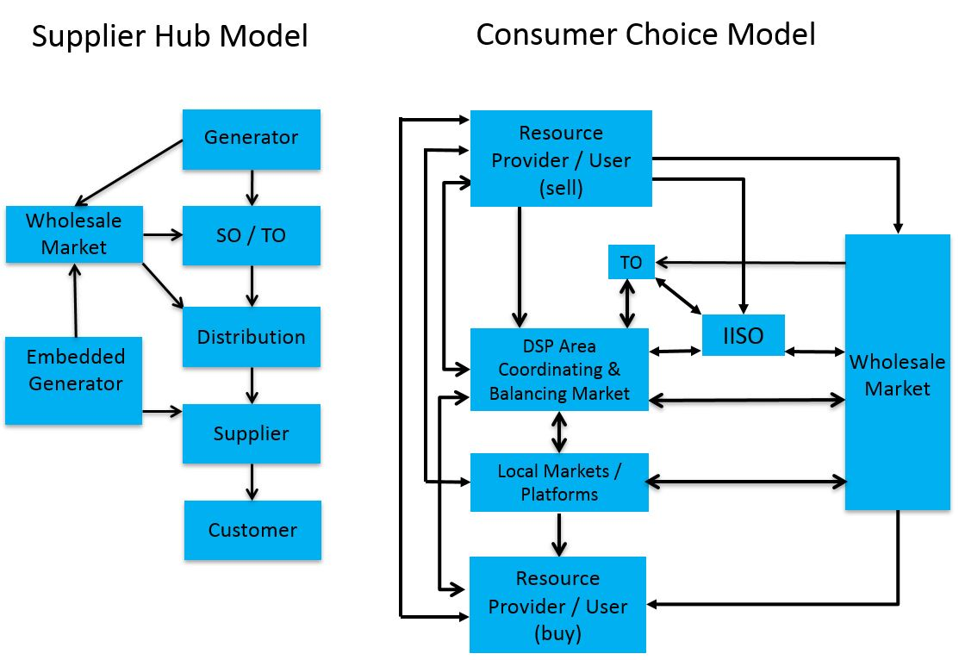
A new model?
Mitchell, C. (2018) Priorities for the UK Energy Market

Slide 13
Consumer Choice model means…
Generators should be able to sell to whom they want.
Customer should be able to buy from whom they want.
DSO/DSP are local coordinators, balancers and integrators of local areas and markets.
Bottom-up / area system optimisation.
LEMs fully operational as area market place within the DSO/DSP network.
Transparency in decision-making.
Being fully informed & involved – as per individual needs.
Also provides the institutional framework to move on from the supplier hub model.

Slide 14
Coordinated decision-making
Overarching Government Strategy
BEIS should develop an Energy Transition Strategy and Implementation Roadmap to guide future decision making by the regulator and then other stakeholders in a coherent manner.
RIIO2
Charging Futures
Supplier Hub Model Review
Access to Data / Blockchain
Open Networks Project
This would give innovators clarity over where best to invest, and how to proceed, in providing a ‘smart and flexible’ energy system which benefits consumers.
HHS and smart meter rollout
Market Rules

Slide 15
Further Info
Bray, R., Woodman, B. and Connor, P. (2018) ‘Policy and Regulatory Barriers to Local Energy Markets in Great Britain’, pp. 1–103. Available at: http://geography.exeter.ac.uk/media/universityofexeter/schoolofgeography/images/researchgroups/epg/09.05.18_Policy_and_Regulatory_Barriers_to_LEMs_in_GB__BRAY._.pdf.
Cornwall Local Energy Market: https://www.centrica.com/innovation/cornwall-local-energy-market

Slide 16
References [1]
Elexon (2017) ‘ELEXON’s response to Ofgem’s call for evidence on future supply market arrangements’
Elexon (2018) ‘Enabling customers to buy power from multiple providers’
ENA (2017) ‘Open Networks Project – DSO Transition: Roadmap to 2030’
HM Government (2016) ‘The Carbon Budget Order 2016’
Lockwood, M. et al. (2017) ‘The governance of industry rules and energy system innovation: The case of codes in Great Britain’
Mitchell, C. (2016) Giving control back to the people
Mitchell, C. (2018) Priorities for the UK Energy Market: competition, infrastructure and innovation Assessing market arrangements and getting the best deal for users
National Grid (2018) Home - Charging Futures. Available at: http://www.chargingfutures.com/
NIC (2018) ‘National Infrastructure Assessment – July 2018’
Ofgem (2017a) ‘Reform of electricity network access and forward-looking charges: a working paper’

Slide 17
References [2]
Ofgem (2017b) ‘Roundtable on regulatory constraints and enablers of blockchain in the GB energy sector’
Ofgem (2017c) ‘State of the energy market 2017’
Ofgem (2017d) ‘The Innovation Link: Update on Regulatory Sandbox’
Ofgem (2018a) Future supply market arrangements – response to our call for evidence
Ofgem (2018b) Half-hourly Settlement update: March 2018
Ofgem (2018c) Industry codes
Ofgem (2018d) RIIO-2 Framework Decision
Ofgem (2018e) Transition to smart meters
ONS (2018) DUKES 2018 Chapter 5: Electricity
Ravens, S. and Lawrence, M. (2017) ‘Defining the Digital Future of Utilities Grid Intelligence for the Energy Cloud in 2030’
Shakoor, A. et al. (2017) ‘Roadmap for Flexibility Services 2030’
WPD (2017) ‘Western Power Distribution DSO Strategy Update - December 2017’

