Slide 1

BEIS Heat Network Consumer Survey
Philip Cole – Department for Business, Energy and Industrial Strategy
Research conducted by
https://www.gov.uk/government/publications/heat-networks-consumer-survey-consumer-experiences-on-heat-networks-and-other-heating-systems
BIEE Conference
Vision and Objectives
Notes:
Cover style 1 (delete if using cover style 2)

Slide 2
Outline
Background
Methodology
Pilot
Results
Use and impact of results
Further research
BIEE Conference
Notes:
Cover style 1 (delete if using cover style 2)

Slide 3
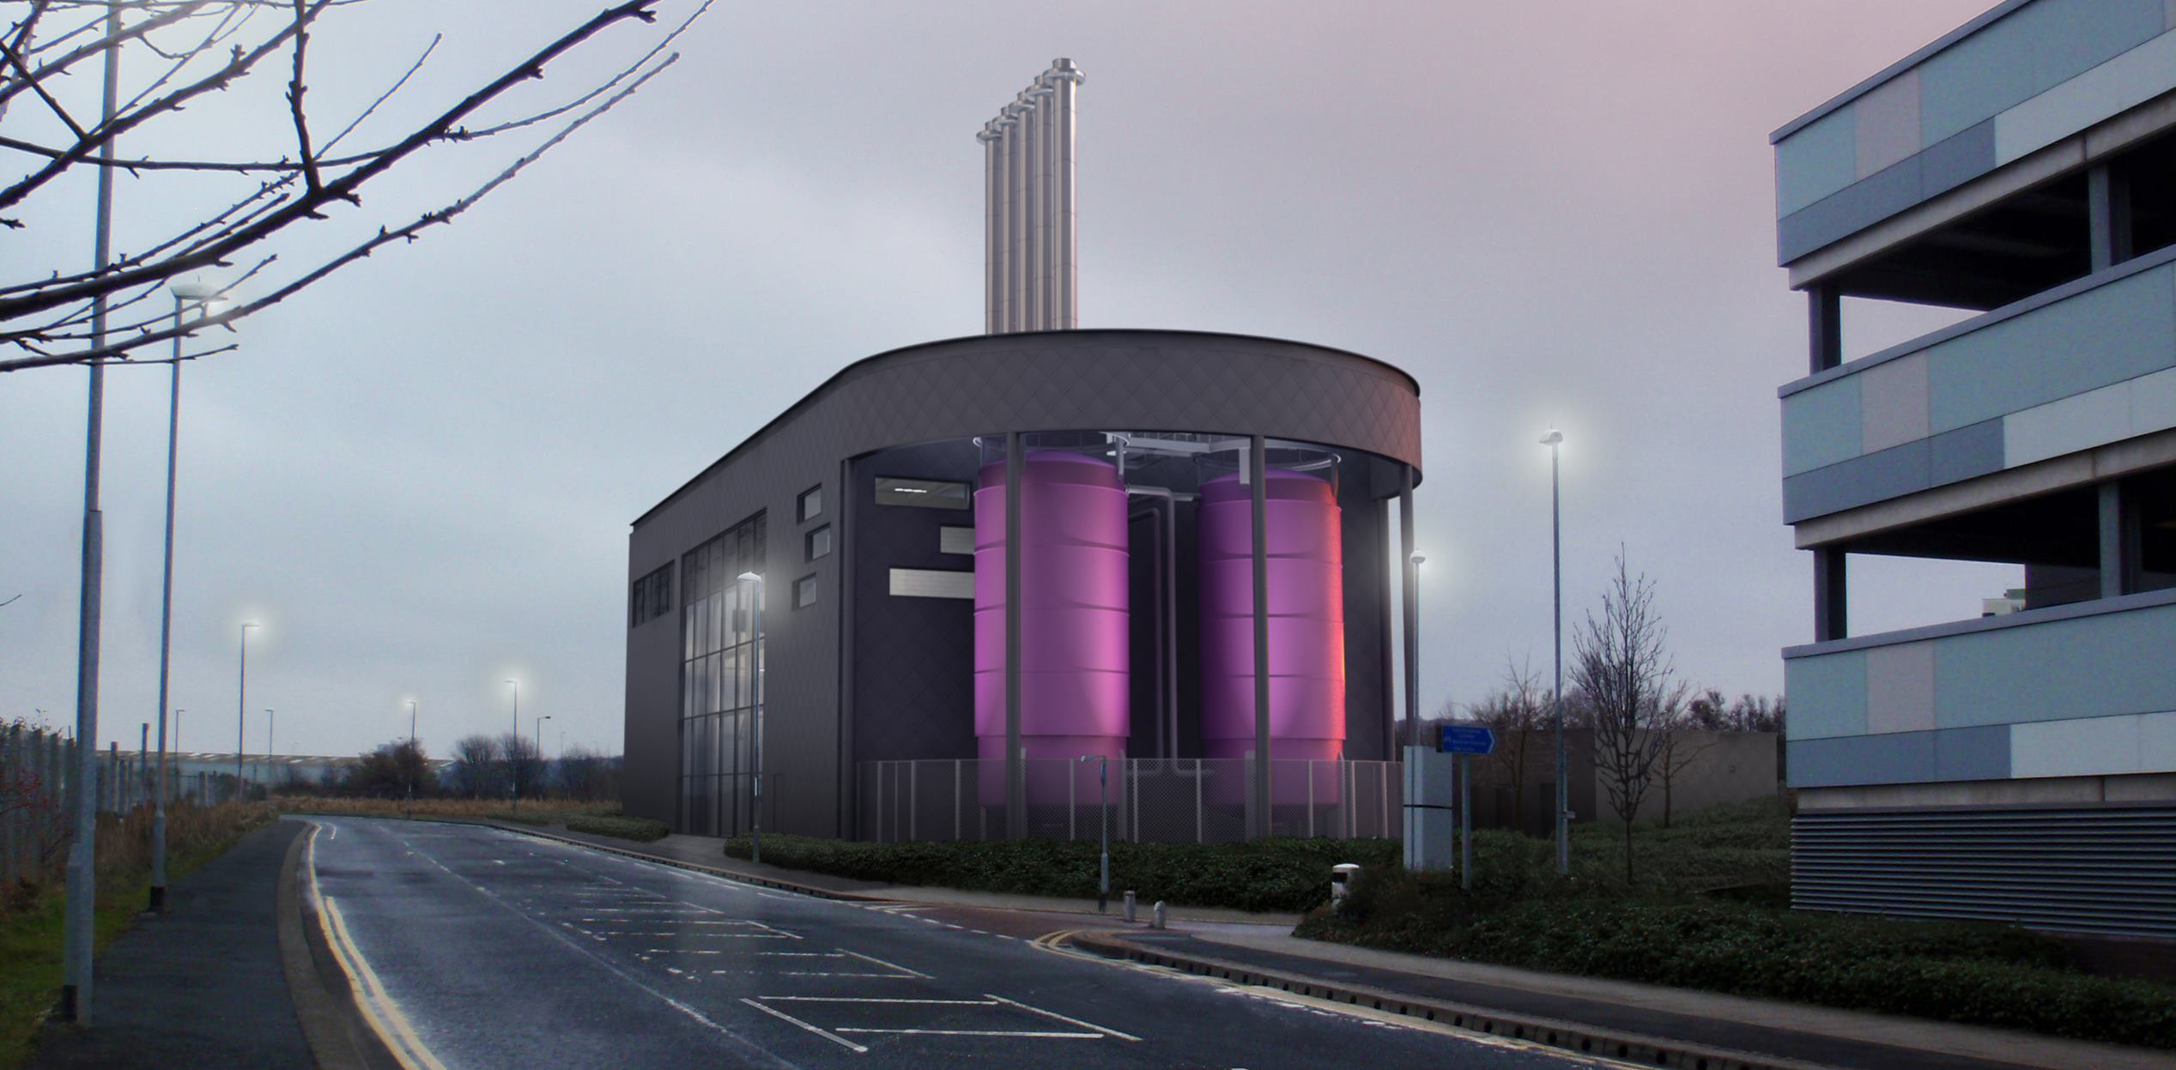
What is a heat network?
Who are heat network consumers?
Why was research needed?
Gateshead District Energy Scheme
BIEE Conference

Slide 4
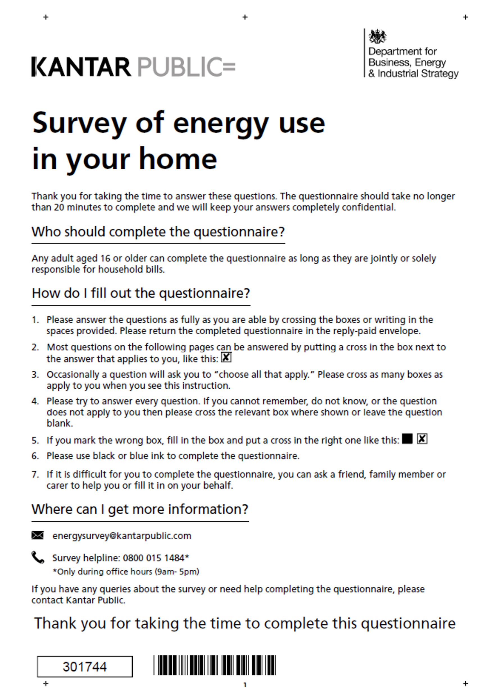




Methodology
BIEE Conference

Slide 5
Pilot Survey
BIEE Conference

Slide 6




Main Survey Results
21%
Response rate
BIEE Conference

Slide 7
Results: Type of network
Network operator
Building / network age
Heat Trust
BIEE Conference

Slide 8
Results: Network Operator
 | Private | Local Authority | Housing Association
Building built since 2000 | 57% | 3% | 18%
Homeowners | 40% | 12% | 7%
Child in household | 12% | 15% | 4%
Employment status: Employed Retired Unemployed | 59% 27% 4% | 32% 45% 7% | 15% 70% 3%
BIEE Conference

Slide 9










Results: Building age
Older networks
(pre 2000)
Newer networks
(post 2000)
BIEE Conference

Slide 10





Results: Heat Trust Networks
BIEE Conference

Slide 11




Research impact
Heat Networks Investment Project (HNIP)
Protecting
consumers
BIEE Conference

Slide 12




Further research
BIEE Conference

Slide 13

Questions?
?
BIEE Conference

