Slide 1
UK Future Energy Scenarios 2015
BIEE 16th October 2014
Marcus Stewart, Energy Supply Manager

Slide 2

We develop scenarios that affect & inform how important decisions are made
Development of
transmission systems
Supply & demand
for the year ahead
Security of supply
& decarbonisation
European developments

Slide 3
We follow an annual cycle of scenario development
Your Views
Axioms
Our stakeholder engagement allows us to listen to your views, which are vital to our outputs. They drive our processes and inform both our scenarios and our consultation process.
An axiom is a premise or starting point of reasoning. The axioms that we produce are a reflection pf the stakeholder feedback that we receive through our consultation process. These axioms influence our modelling.
Future Energy Scenarios
Modelling
The scenarios are the end result and a vision of the future that stakeholders have informed. The publication of the Future Energy Scenarios document marks the start of our annual process and the continuation of our stakeholder consultation.
Once our axioms have been defined, they underpin our detailed modelling and drive our specific electricity and gas, demand and supply scenarios.

Slide 4
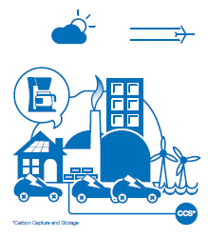





What do the 2014 scenarios look like?
Low Carbon
Life
Gone Green
Affordability
More money
Affordability
Less money
No
Progression
Slow
Progression
Sustainability
Less emphasis
Sustainability
More emphasis

Slide 5
Energy Demand

Slide 6
Residential energy for gas is stable to
2020, range of outcomes for electricity is wider
Gas
Efficiencies balance growth
No Progression
TWh/yr
Uptake of Heat Pumps
Gone Green
Gone Green
Electricity
Low Carbon Life
No Progression
Electrification of transport
Gone Green
Slow Progression

Slide 7
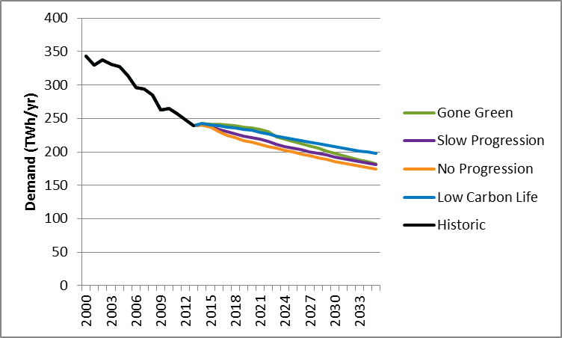
Industrial & Commercial gas demand continues to decline
Sectoral change, energy efficiency and fuel switching drives decline
I&C Gas Demand
Notes:
Decline since 2000
Sectoral shift from manufactrureing to services
Commercial affected by fuel switching
Industry efficiency and closures
IED assumptions imapcting larteg users biomass comversions,

Slide 8
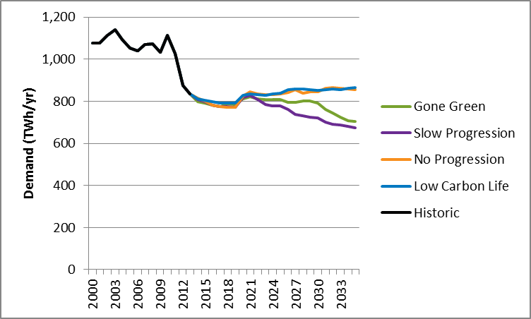
Gas demand falls in the greener scenarios and plateaus in the other two
Power generation maintains demand
Total Gas Demand
Fuel switching and energy efficiency
Notes:
Short term range is lower than last year (7-10%)

Slide 9
Power Supply

Slide 10
In all our scenarios we expect coal to reduce rapidly, and gas to initially fill the gap
The increase in gas fired plant in order to compensate for coal closure profile
Early IED opt out
Aggressive closure profile across all scenarios
Remaining plant assumed to comply with IED or be converting to CCS

Slide 11
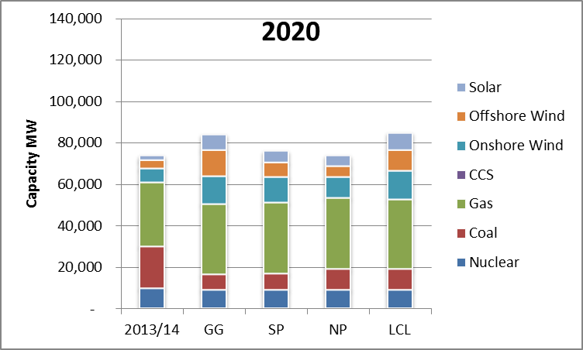
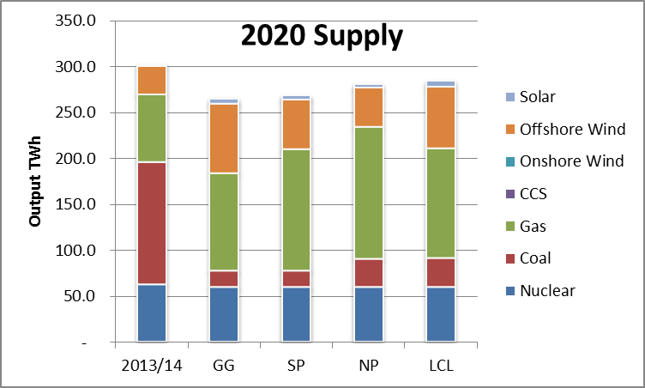
By 2020 Gas will be the dominant generation fuel, with wind and solar more prevalent in the wealthier scenarios
Generation scenarios
Gas capacity and usage increases across all scenarios

Slide 12
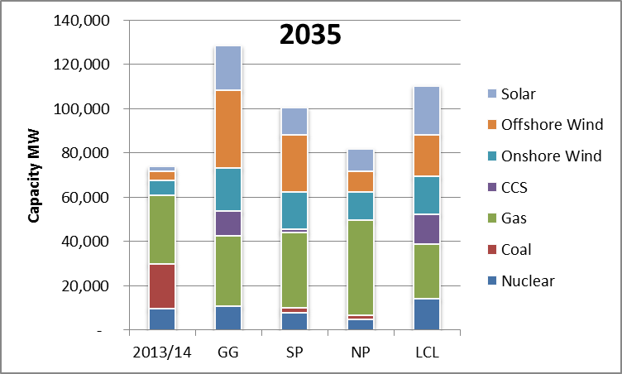
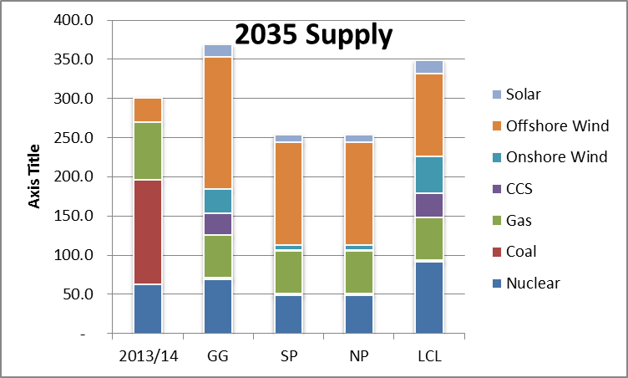
By 2035 we have a much wider range, with CCS for gas in the greener scenarios
Generation scenarios
Gas capacity retained but annual usage changes

Slide 13
Gas Supply

Slide 14
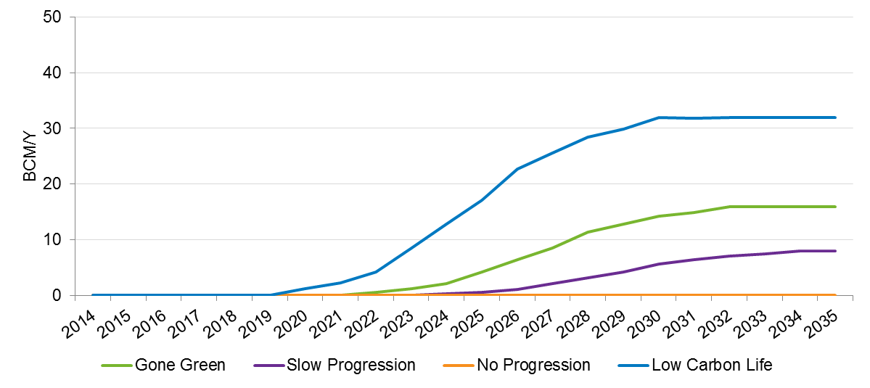
Due to the large amount of uncertainty around Shale production we have a broad range
Annual Production
Low Carbon Life
Gone Green
Slow Progression
No Progression

Slide 15
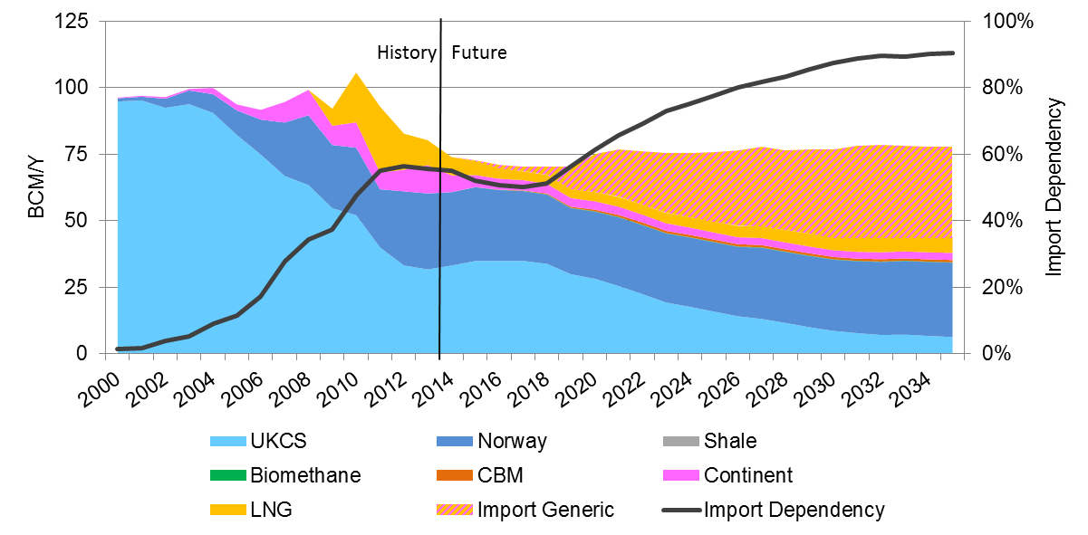
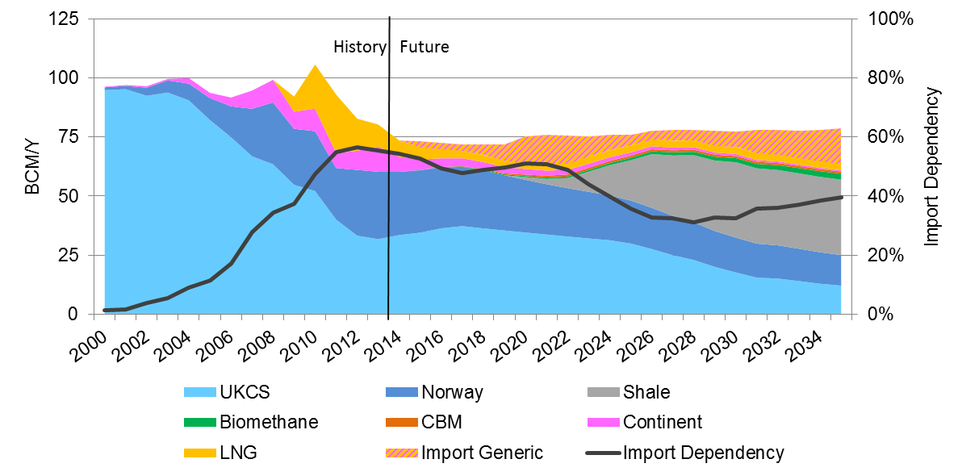
Shale has the potential to significantly impact import dependency
Annual gas supplies
No Progression
Import
dependency
Low Carbon Life

Slide 16
Summary
Broad range of plausible and credible scenarios to capture uncertainty
Demand for gas is expected to plateau or fall
However, gas still has an important role in both heat and power out to 2035
Shale could have a big impact on import dependency

Slide 17
Issues for the coming winter?
Demand expected to be very similar to last year
Gas supply position secure
Diverse supply
Storage well stocked
Impact of Russian gas curtailment low

Slide 18
Thank You

