Slide 1
Swarm demand response
Virtual storage by small consumers
Joachim Geske, Richard Green
BIEE Conference, Blatvanik School of Government, 18 September 2018, Oxford

Slide 2
Motivation
Electricity systems with large share of intermittent renewables need flexibility
May be provided by generation, or storage, or demand response (DR)
DR in the industrial sector useful but potential is not unlimited
Swarm DR (sDR) based on shifting small loads in the residential sector,
    by only a tiny interval of minutes,
    smartly coordinated,
    delegated or automated
    could have significant potential to augment it
What is the potential of sDR on the electricity system level?

Slide 3
Swarm demand response: virtual storage by small consumers
To answer this question:
What is sDR? (frequently shifting small loads for short periods in a way that may be costless for the user)
How much potential is there?
  What loads can be shifted?
  How many consumers would participate?
  How much conventional storage is this equivalent to?
Conclusion
Notes:
Verbesserung: Konsum der mehr als eine Periode dauert steht zum shifting in der nächsten Periode nicht zur Verfügung.

Slide 4
1. What is sDR? – load shifting
Traditional DR: Shifting a single load (e.g. industrial process) by several hours
Load
Load
Time
Swarm DR: Shifting a series of small loads by a couple of minutes each
Load
Load
Load
Load
Load
Load
Load
Load
Time

Slide 5
1. What is sDR? – load shifting
Traditional DR: Shifting a single load (e.g. industrial process) by several hours
Load
Load
Time
Swarm DR: Shifting a series of small loads by a couple of minutes each
Load
Load
Load
Load
Load
Load
Load
Load
Time
→ By shifting a series of loads also „long term“ storage possible

Slide 6

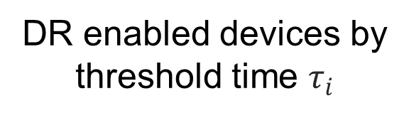

1. What is sDR? – costless load shifting
devices with shifting indifference (threshold) time
Cost = inconvenience
indifference
threshold curve
$$E$$
No delay cost
$$τ_{6}$$
Gradually increasing cost of delay
$$τ_{5}$$
$$τ_{4}$$
DR enabled devices by
threshold time $τ_{i}$
$$τ_{3}$$
$$τ_{2}$$
$$τ_{1}$$
$$t$$
preferred time to start using devices
Actual start time of device use
Notes:
Indifference threshold is identity function
The devices do not neccessarily have the same operating time

Slide 7


1. What is sDR? – costless load shifting
shifting devices 4, 5 and 6 by 𝜟t
device 6 does not incur a cost
We are only interested in costlessly shiftable devices
$$E$$
𝜟t
$$τ_{6}$$
S
These devices incur a cost
$$τ_{5}$$
$$τ_{4}$$
$$τ_{3}$$
$$τ_{2}$$
$$τ_{1}$$
$$t$$
Notes:
Indifference threshold is identity function
The devices do not neccessarily have the same operating time

Slide 8
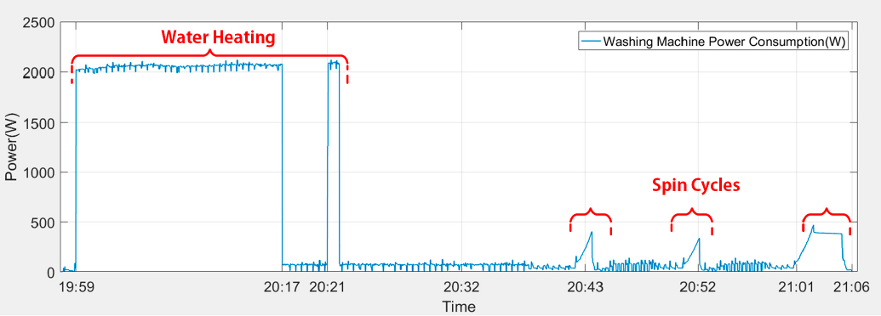
1. What is sDR? - Example: washing machine
Source: F. Issi and O. Kaplan, 2018:"The Determination of Load Profiles and Power Consumptions of Home Appliances", Energies 2018, 11, 607.
Washing Machine Panel
Favourite
Cotton Intensive
Cotton 40
Cotton 60°
Cotton 40°
Cotton 20°
Power
Delay
Speed
Temp.
Start
Pause
Express 15’
Eco
Planned End of Program: 19:05
Rise&Spin
Spin Only
Latest End of Program: 20:05
+
-

Slide 9
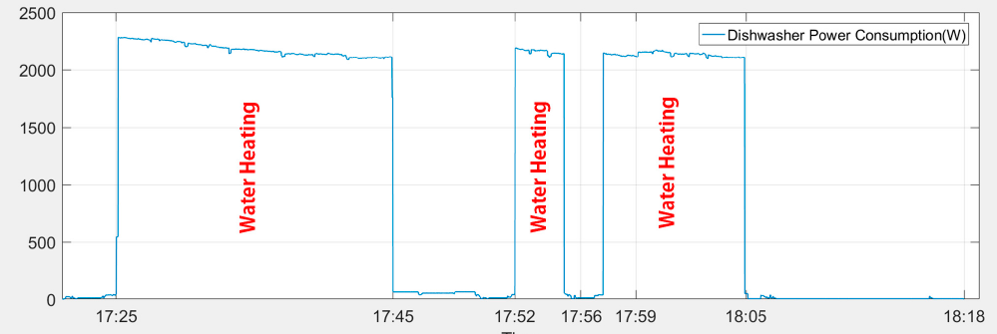
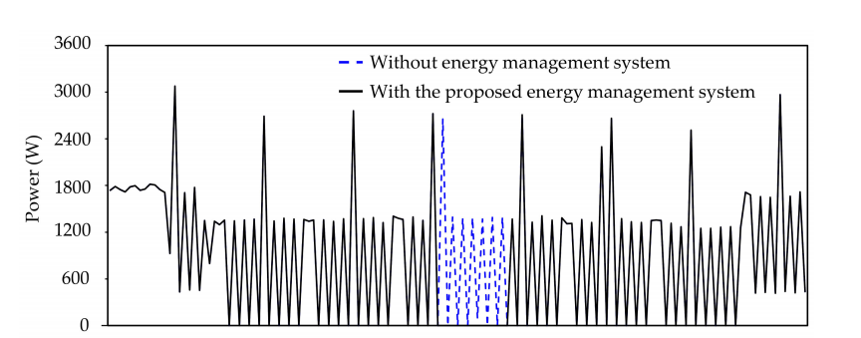
1. What is sDR? - Examples
Dishwasher
Power [W]
Source: F. Issi and O. Kaplan, 2018:"The Determination of Load Profiles and Power Consumptions of Home Appliances", Energies 2018, 11, 607.
Electrical heater
Power [W]
21:39
22:00
22:30
23:00
23:30
Source: S. Bissey, S. Jacques, and J.-C. Le Bunetel, 2017: "The Fuzzy Logic Method to Efficiently Optimize Electricity Consumption in Individual Housing", Energies, 10, 1701

Slide 10
2. How much potential is there? What loads can be shifted?
Participation rate: Appliances, example household
Device | Duration | Usage Density | Monthly Cons. [kWh] | Costlessly shiftable? | Energy [kWh]
Refrigerator | 24 h | All time | 23.5 | ✓ | 23.5
Washing machine | 4x1 h | 1 per week | 8.0 | ✓ | 8.0
Dishwasher | 3 h | 8 per month | 7.4 | ✓ | 7.4
Oven | 50 min | 4 per week | 16.4 | ✗ | 0
Iron | 38 min | 1 per week | 1.9 | ✗ | 0
Hair dryer | 43 min | 1 per week | 5.0 | ✗ | 0
Kettle | 1 min 53 sec | 9 per week | 6.8 | ✗ | 0
Range hood | 34 min | 8 per week | 1.1 | ✗ | 0
Toast | 13 min | 14 per month | 2.9 | ✗ | 0
Printer | 7 min 53 sec | 16 per month | 2.9 | ✗ | 0
TV | 4 h 17 min | 22 per month | 8.4 | ✗ | 0
PC | 2 h 14 min | everyday | 14.9 | ✗ | 0
Total |  |  | 99.4 |  | 38.5
 |  |  |  |  | 40%
Source: F. Issi and O. Kaplan, 2018:"The Determination of Load Profiles and Power Consumptions of Home Appliances", Energies 2018, 11, 607.

Slide 11
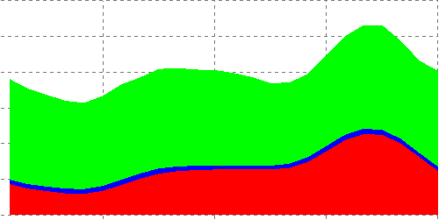
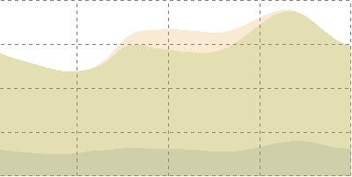
2. How much potential is there?
How many consumers would participate?
Shiftable load component | Participation rate
Appliance | 40%
Water | 0%
Heating | 70%
Cooling | 70%
Load profiles 2030 (DESSTINEE)
30
UK residual load weekday winter
GW
20
heating
10
water
appliances
0
6
12
18
24
Weighted sum → shiftable load
Hour
GW
UK residual load weekday winter
80
60
solar
40
non-shiftable residual Load
20
shiftable Load
Hour
0
6
12
18
24

Slide 12
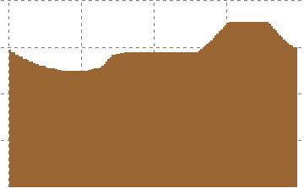
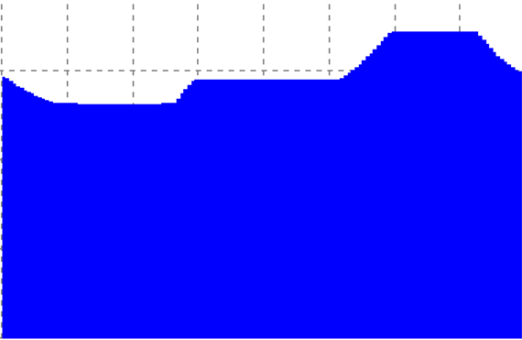
2. How much potential is there?
How much conventional storage is this equivalent to?
Shiftable load
Storage Capacity = 12GWh
Optimization of DR Model
Optimization of a storage Model
Generation Profile
Generation Profile
☹
GW
GW
Generation DR weekday winter
80
80
60
60
40
40
20
20
0
6
12
18
24
0
6
12
18
24
Hour
Hour
Storage Capacity > sDR potential → lower storage capacity

Slide 13
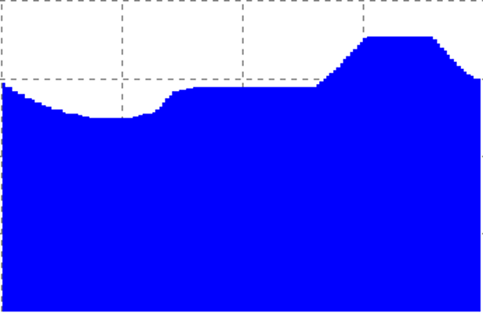
2. How much potential is there?
How much conventional storage is this equivalent to?
Shiftable load
Storage Capacity = 9GWh
Optimization of DR Model
Optimization of a storage Model
Generation Profile
Generation Profile
GW
GW
✓
Generation DR weekday winter
80
80
60
60
40
40
20
20
0
6
12
18
24
0
6
12
18
24
Hour
Hour
sDR equivalent to a conventional storage of 9 GWh during a winter day

Slide 14
3. Conclusion
Interpretation of DR in the residential sector (quantified model)
sDR ≈ conventional storage with variable capacity between 2 and 9 GWh.
sDR might replace expensive conventional storage or enable countries without a natural storage potential.
sDR enabled by communication technology could provide flexibility for the power system with high shares of renewables, but its reliability will need to be seen to be proved.
Prices ‘find’ successive shifters to smooth load shifting in a welfare enhancing way. No evidence of spikes!
→ A swarm of imperceptible demand shifts directed by market signals behaves like a gigantic storage unit, unknown to participants.

Slide 15


