Slide 1
^{Diversity behind the meter} machine learning from household activities
Phil Grunewald, Marina Diakonova, Aven Satre-Meloy

Slide 2
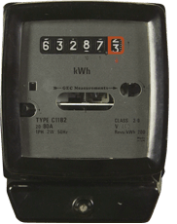
The Problem
“The system”
“The people”
This is where the system ends
All kWh are created equal
All kWh are costly (must be charged)
All kWh are polluting (must be avoided)
This is where it gets interesting
All energy services are different
Some services are pointless
Some services are very very valuable

Slide 3
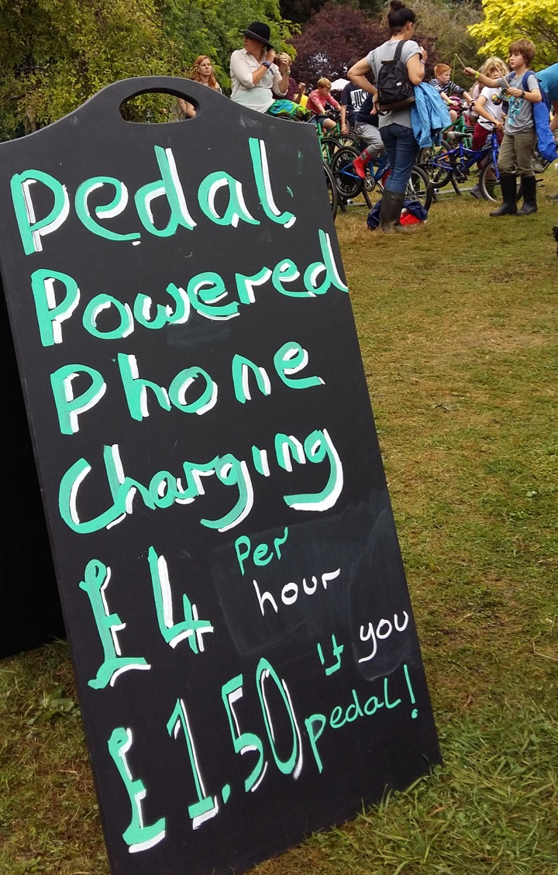
£ 800,000
per MWh

Slide 4
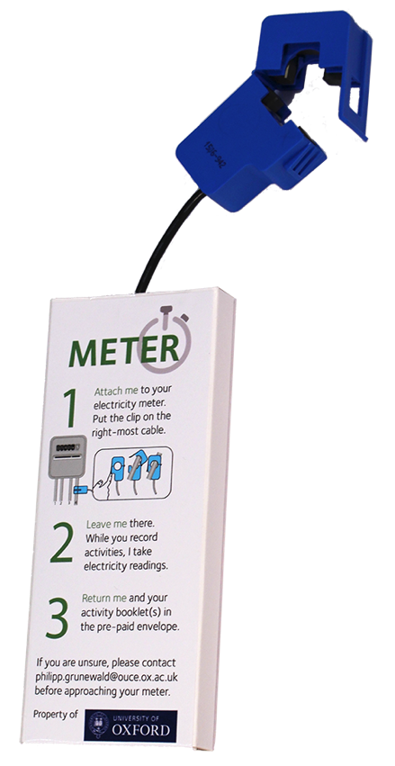
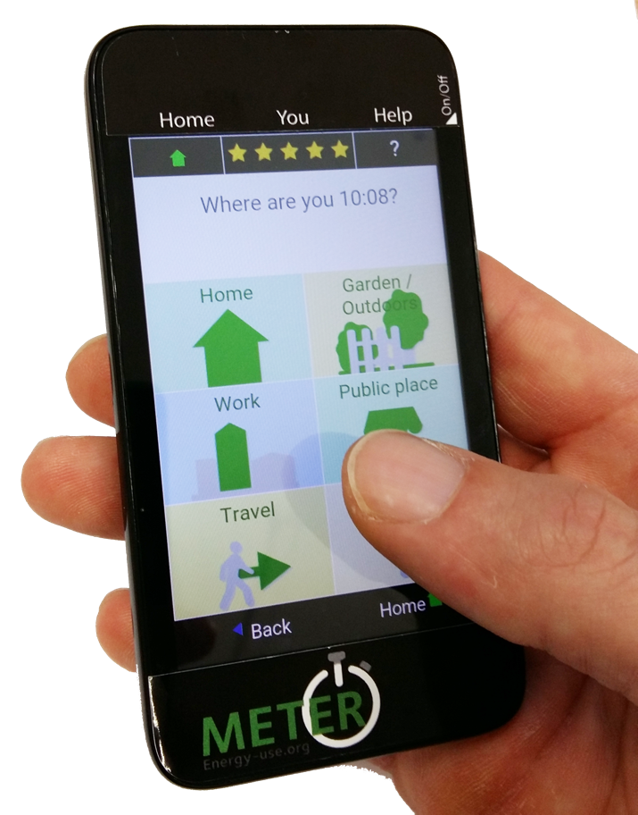

Slide 6
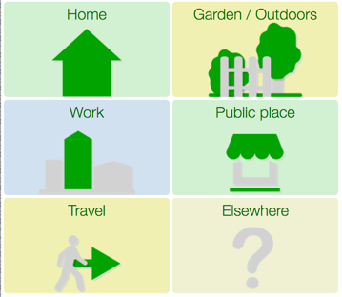
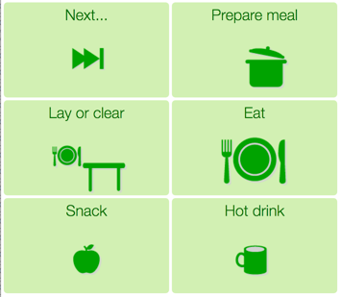
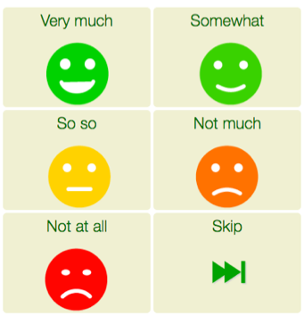
3 selections → discriminate 216 options (…1,296…)

Slide 7
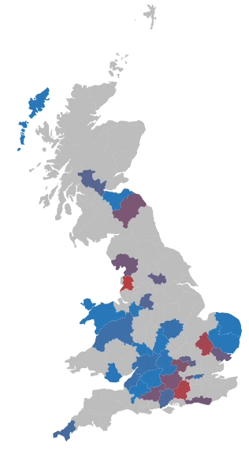
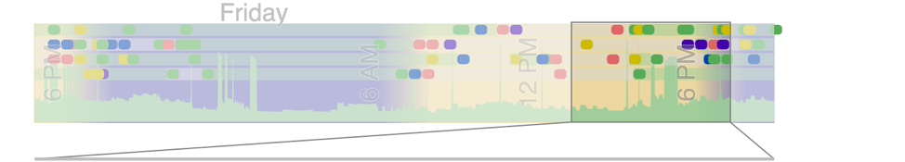
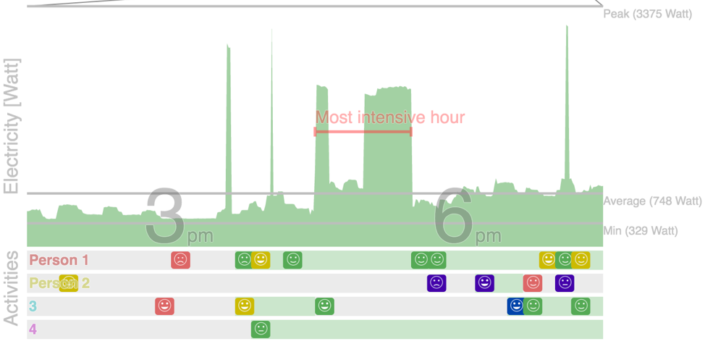
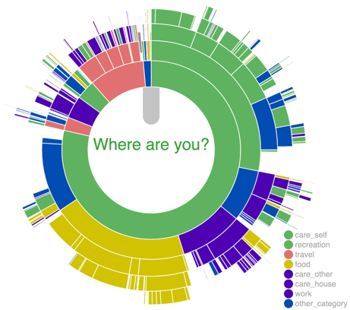
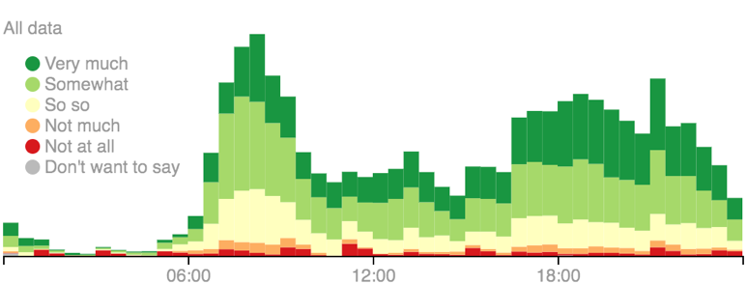
Household Load and Activity Profile
Electricity
Activities
Enjoyment

Slide 8
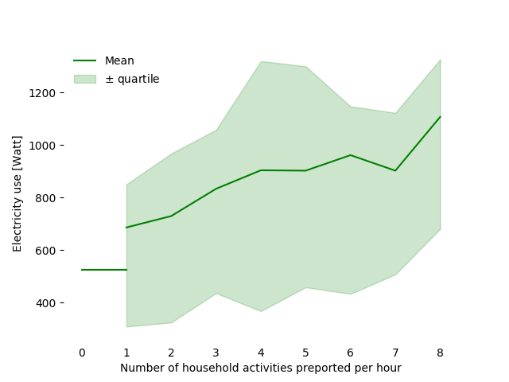
Report more – use more

Slide 9
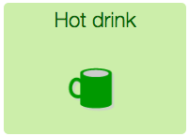
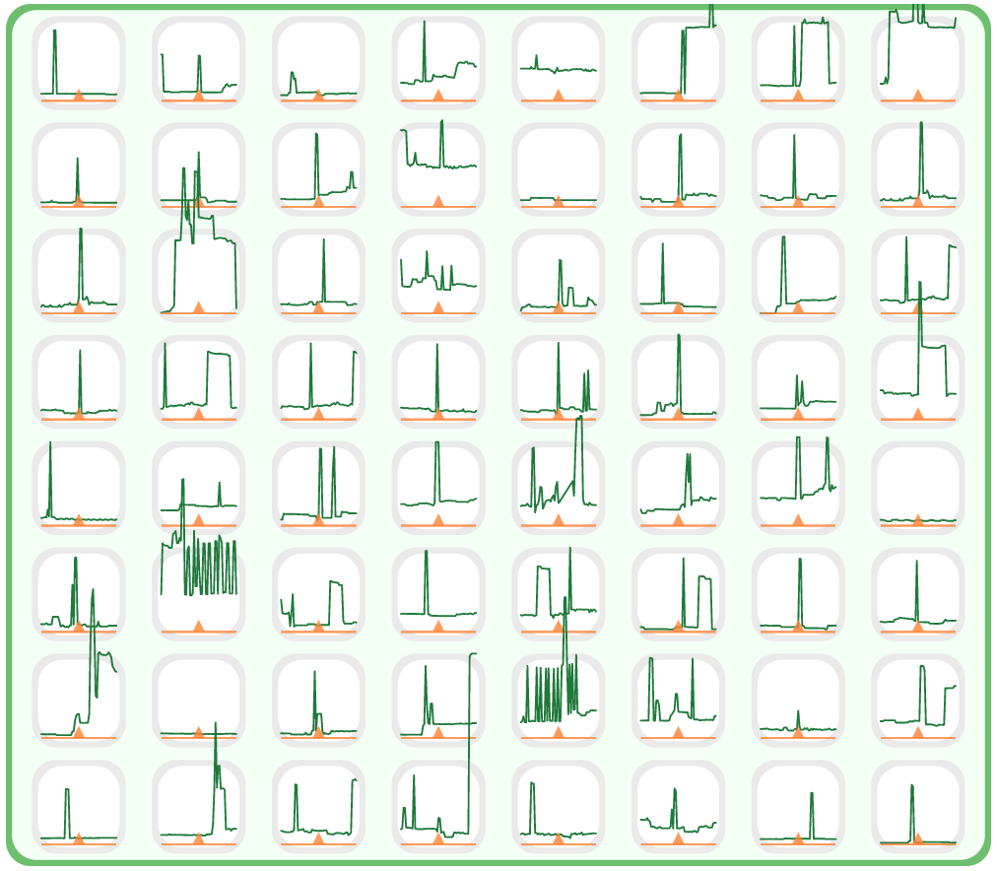
53% of individuals
and
73% of households
report
Hot drink / Tea

Slide 11
Power footprint of activities

Slide 12
High and low use activities/appliances
Multi-occupant household
Single-occupant household
P. Grunewald and M. Diakonova. The electricity footprint of household. Energy & Buildings, 2018.

Slide 13




Charge car
Oven
Watt
Washing
Tea

Slide 14


Bedtime
Get home

Slide 15
60min
30min
branches
10min
ActiviTree
Time
10min
roots
30min
60min

Slide 16
Pair-Tree

Slide 17
PairTree probability
p=80% (!)
p=38%

Slide 18
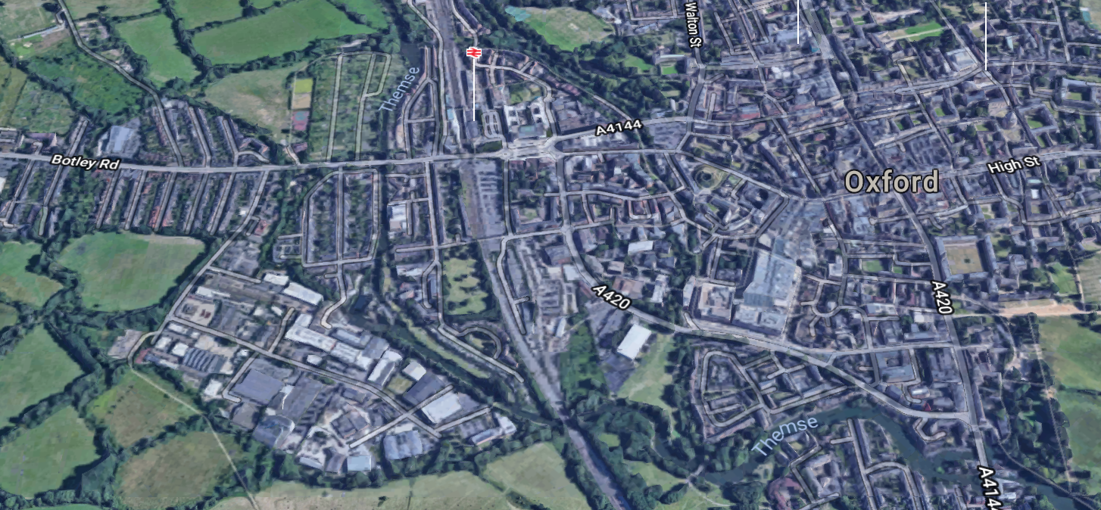
West Oxford Street Challenge
With Low Carbon West Oxford
5 Streets within a neighbourhood
High uptake – 74 people in 28 households (snowballing)

Slide 19
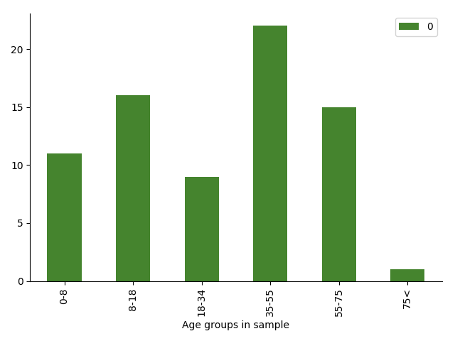
West Oxford Street Challenge
Non representative, but diverse sample
Age
Income

Slide 20
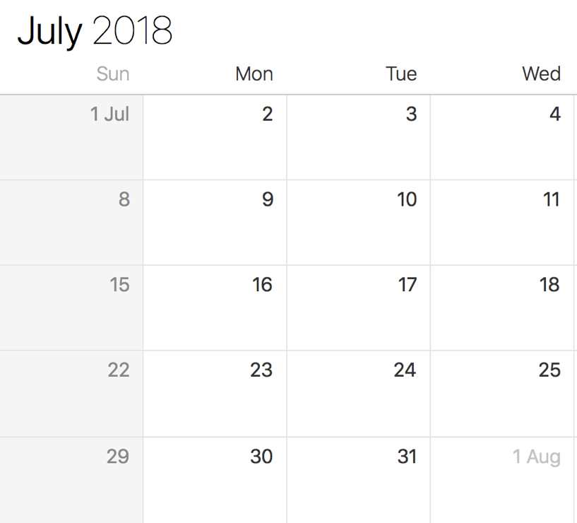
4 Trial periods – Sunday to Monday
Observation
5pm – 9pm
Intervention
5pm – 7pm
No drop outs – only absence due to holidays

Slide 22
Response (Watt)
Absolute reduction 109W
Share of Households
-400W
-200W
+200W
+400W
Relative reduction 15%
Share of Households
-60%
-20%
+20%
+80%

Slide 23

Response (Activities)
6616 activities (out of total 27,272)
Fewer activities reported (performed?) on intervention days
Fewer participants, too…
36
No intervention
32
Intervention
Activities reported
per participant
Trial 1 2 3 4

Slide 24
Electricity and enjoyment

Slide 25


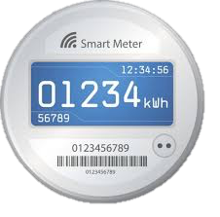


The future
Download the app
Opt into smart meter use

Slide 26
The Solution
There is value in looking at both sides of the meter

Slide 27















Thank you
Marina
Russ
Adriano
Miriam
Davide
Aven

