Slide 1
What do future utilities need: consent and dissent from incumbents and policy makers in Decision Theatres
Dr Christoph Mazur*, Professor Jillian Anable, Dr Stephen Hall, Dr Jeffrey Hardy, Dr Mark Workman, Marie-Sophie Wegner & Dr Mark Powell
Research Fellow
Imperial College London
Christoph.mazur@imperial.ac.uk | @christophmazur

Slide 2






Project team
Dr Mark Workman
Marie-Sophie Wegner
Dr Stephen Hall
Professor Jillian Anable
Dr Mark Powell
Dr Christoph Mazur
Dr Jeff Hardy

Slide 3
Utility 2050 overview
Value Pool Analysis
(Modelling)
Future Electricity Value Pools (up to £21bn or 14-31% of market size by 2050)
Applied Energy on Value Pools
Business Model Generation
(Workshops)
Crowd sourced novel Business Models that could capture current and future Value Pools
Technology Barriers Analysis
(Surveys)
There are no critical technology barriers that hinder these Business Models
Identification of barriers and enablers
Consumer Insights
(Surveys & Interviews)
All business models appeal to some consumers
Emerging consumer segmentation
Consumer and data protection are critical issues not being addressed.
Expert insights
(Decision Theatres)
Heat and electric transport strategy
Carbon pricing critical
Principles based regulatory framework required

Slide 4
Decision Theatres
Decision Theatres are workshops that culminate in participant/stakeholders making a decision.
DTs are one off events framed within a longitudinal research process that may involve several DTs, groups of participants, and decision-making dilemmas.

Slide 5
Decision Theatres
Arizona State University: to consider decision-making in a context of climate uncertainty. To explore complex relationships that exist between rapidly growing populations, and finite water supplies
At Newcastle University have likewise considered how Newcastle City residents engage with Climate Change and pluvial flood risk, as experienced during Thunder Thursday in 2013.
[Ibuild Project] To research District-Heat Network development and understand what policy changes might be required to support wider take-up.
[Ibuild Project] To explore the character of business models required to support to the development of Energy Centres
[Ibuild Project] Developed from the Energy Centre DT above, this DT considered how future Electric Vehicle Charging Infrastructure might be financed and developed within the UK.

Slide 6
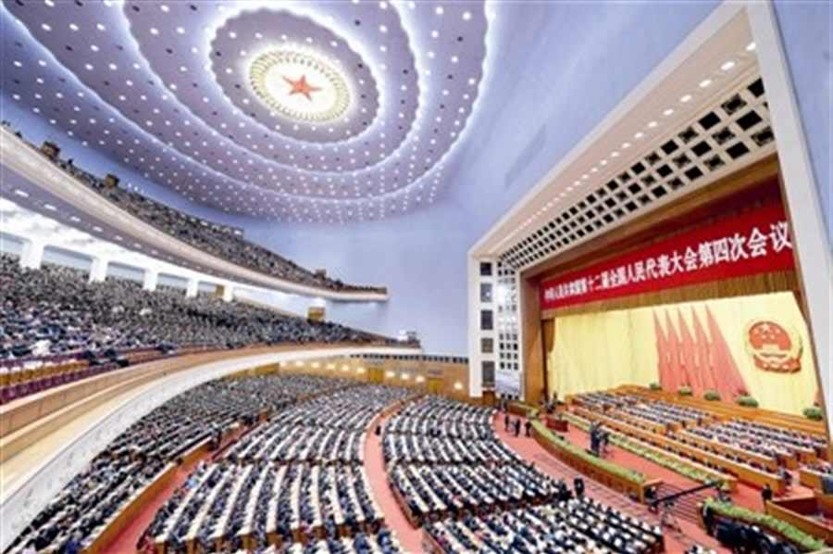

‘Given absolute power, what are the changes you would make to the system to allow current and new utilities, start-ups, and disruptors to capture new values?’

Slide 7
Inputs into the workshop (and context)

Slide 8
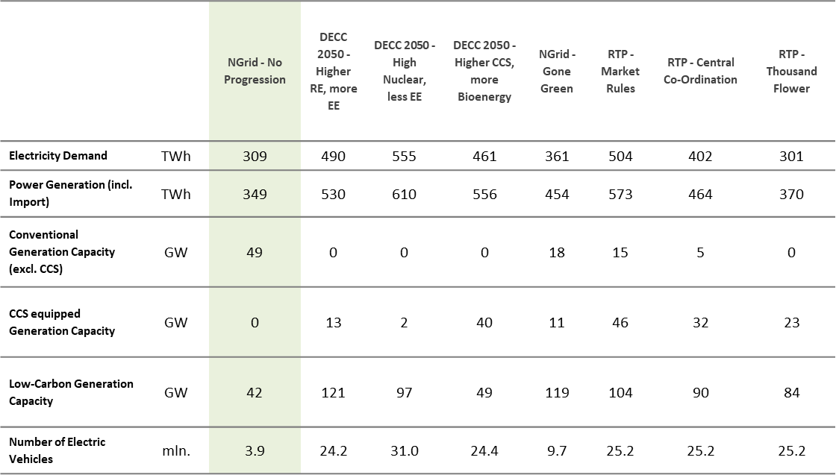
Value pools: Scenarios
Value Pool Analysis
(Modelling)

Slide 9






Size of the prize for future electricity utilities
Value Pool Analysis
(Modelling)
Up to £21 bn of new value is available to electricity utilities per year by 2050
Plant efficiency
£75 – 1809 m
Service provision
£5 – 9 bn
Local LC generation
£42 – 4600 m
Large LC generation
£0.61 – 8 bn
Flexibility optimisation
£400 – 2000 m
CCS
£-0.14 – 1669 m
Wegner, M.-S., Hall, S., Hardy, J., Workman, M., 2017. Valuing energy futures; a comparative analysis of value pools across UK energy system scenarios. Appl. Energy 206, 815–828. doi:10.1016/j.apenergy.2017.08.200

Slide 10
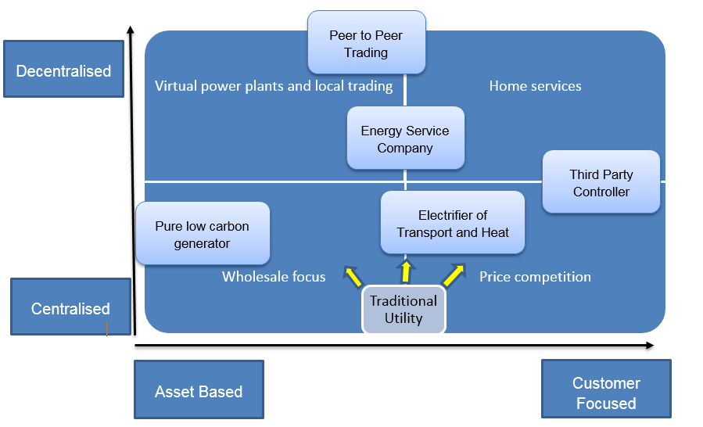
Business Model Generation
(Workshops)

Slide 11
Outputs from the workshops
Expert insights
(Decision Theatres)
Decision Theatres:
1st DT with UK Utilities
2nd DT with UK Policy Makers
3rd DT with EU International Mixed Audience
4th DT with US Mixed Audience

Slide 12
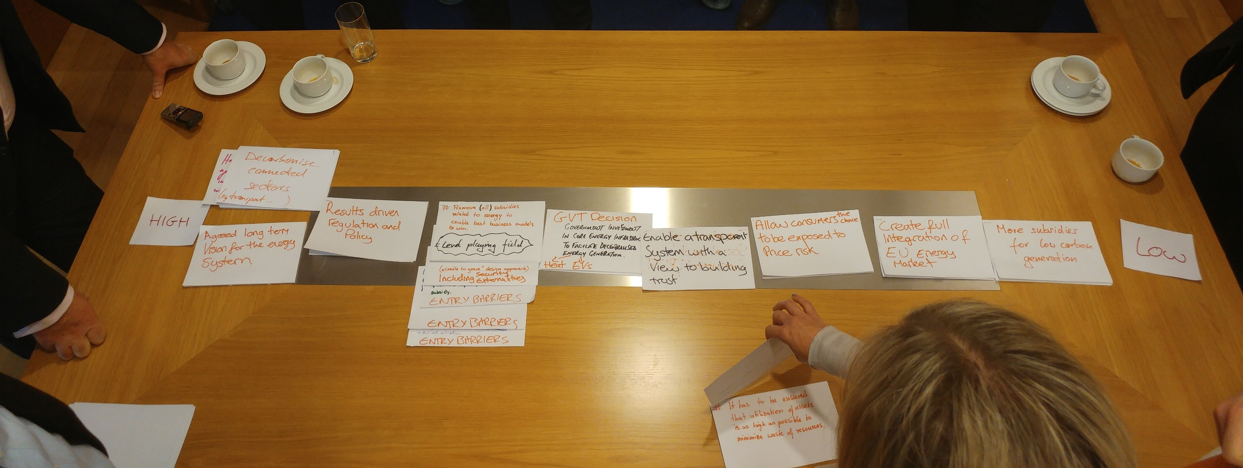
Impressions
Expert insights
(Decision Theatres)

Slide 13
Decision Theatres Results
Expert insights
(Decision Theatres)
UK Utilities
UK Policy
International
(EU)
International
(US)
Markets and innovation
“The regulatory framework needs to adapt so that new products and services can emerge”
“Create markets, including for flexibility, that are accessible, cost reflective, transparent and technology/business model agnostic.”
We need to create open, data driven platforms to provide actionable evidence to improve & develop energy system (management) tools and regulations
Enable flexibility services on an open platform
Simpler regulatory framework
“We need a simpler institutional framework to support the energy transition”
“Ofgem moves to principles based regulation across the supply chain.”
“We need to reduce regulatory barriers to drive market innovation and efficiency”
Consumer benefits and protection
“New markets need to develop to allow customers to benefit from flexibility, while maintaining an acceptable social contract ”
“Customers should be protected from innovation by a fall back mechanism.”
“We need to design and operate an equitable consumer-oriented market to ensure consumer engagement and fair access to energy”
Transport and heat strategy
“We need a national strategy for the electrification of heat”
“Commit to a national energy vision 2050, including transport and heat, with roadmap. “
Carbon pricing
“There must be long term certainty about UK carbon pricing that is compatible with the Paris agreement”
“Decide and communicate: Are we going for low carbon capacity markets or energy only market with sufficient carbon price?”
“We need to place incentives & penalties on energy & carbon use, down to the individual level to spur investment in clean energy technology and to meet carbon targets”

Slide 14
Conclusions
Expert insights
(Decision Theatres)
The results show that there is substantial but not universal agreement on the 5 priorities for change, these are:
A transparent commitment to carbon pricing.
A clear strategy on transport and heat.
Controlling consumer risk.
A reformed regulatory framework across the supply chain.
A framework and platform that allows new energy services to emerge.

Slide 15
Thanks
UK Utilities
UK Policy
International
(EU)
International
(US)
Markets and innovation
“The regulatory framework needs to adapt so that new products and services can emerge”
“Create markets, including for flexibility, that are accessible, cost reflective, transparent and technology/business model agnostic.”
We need to create open, data driven platforms to provide actionable evidence to improve & develop energy system (management) tools and regulations
Enable flexibility services on an open platform
Simpler regulatory framework
“We need a simpler institutional framework to support the energy transition”
“Ofgem moves to principles based regulation across the supply chain.”
“We need to reduce regulatory barriers to drive market innovation and efficiency”
Consumer benefits and protection
“New markets need to develop to allow customers to benefit from flexibility, while maintaining an acceptable social contract ”
“Customers should be protected from innovation by a fall back mechanism.”
“We need to design and operate an equitable consumer-oriented market to ensure consumer engagement and fair access to energy”
Transport and heat strategy
“We need a national strategy for the electrification of heat”
“Commit to a national energy vision 2050, including transport and heat, with roadmap. “
Carbon pricing
“There must be long term certainty about UK carbon pricing that is compatible with the Paris agreement”
“Decide and communicate: Are we going for low carbon capacity markets or energy only market with sufficient carbon price?”
“We need to place incentives & penalties on energy & carbon use, down to the individual level to spur investment in clean energy technology and to meet carbon targets”

