Slide 1
Exploring socioeconomic and temporal characteristics of British and German residential energy demand
Russell McKenna¹, Max Kleinebrahm¹, Timur Yunusov², Máté Janos Lorincz², Jacopo Torriti²
1 Chair of Energy Economics, KIT, Karlsruhe, Germany
2 School of Built Environment, University of Reading, UK

Slide 2
Contents
Introduction and objectives
Important socioeconomic variables for energy and power demand
Methodology
Overall approach
Occupancy and activity probabalities from TU data
Deriving load profiles with Markov chains and TPMs
Results:
Some lessons learned from analysing two datasets
“Validation” with standard load profiles
Comparison of two countries in activities and load profiles
Comparison of different socioeconomic groups
Discussion
Conclusions and outlook
Exploring socioeconomic and temporal characteristics of British and German residential energy demand

Slide 3
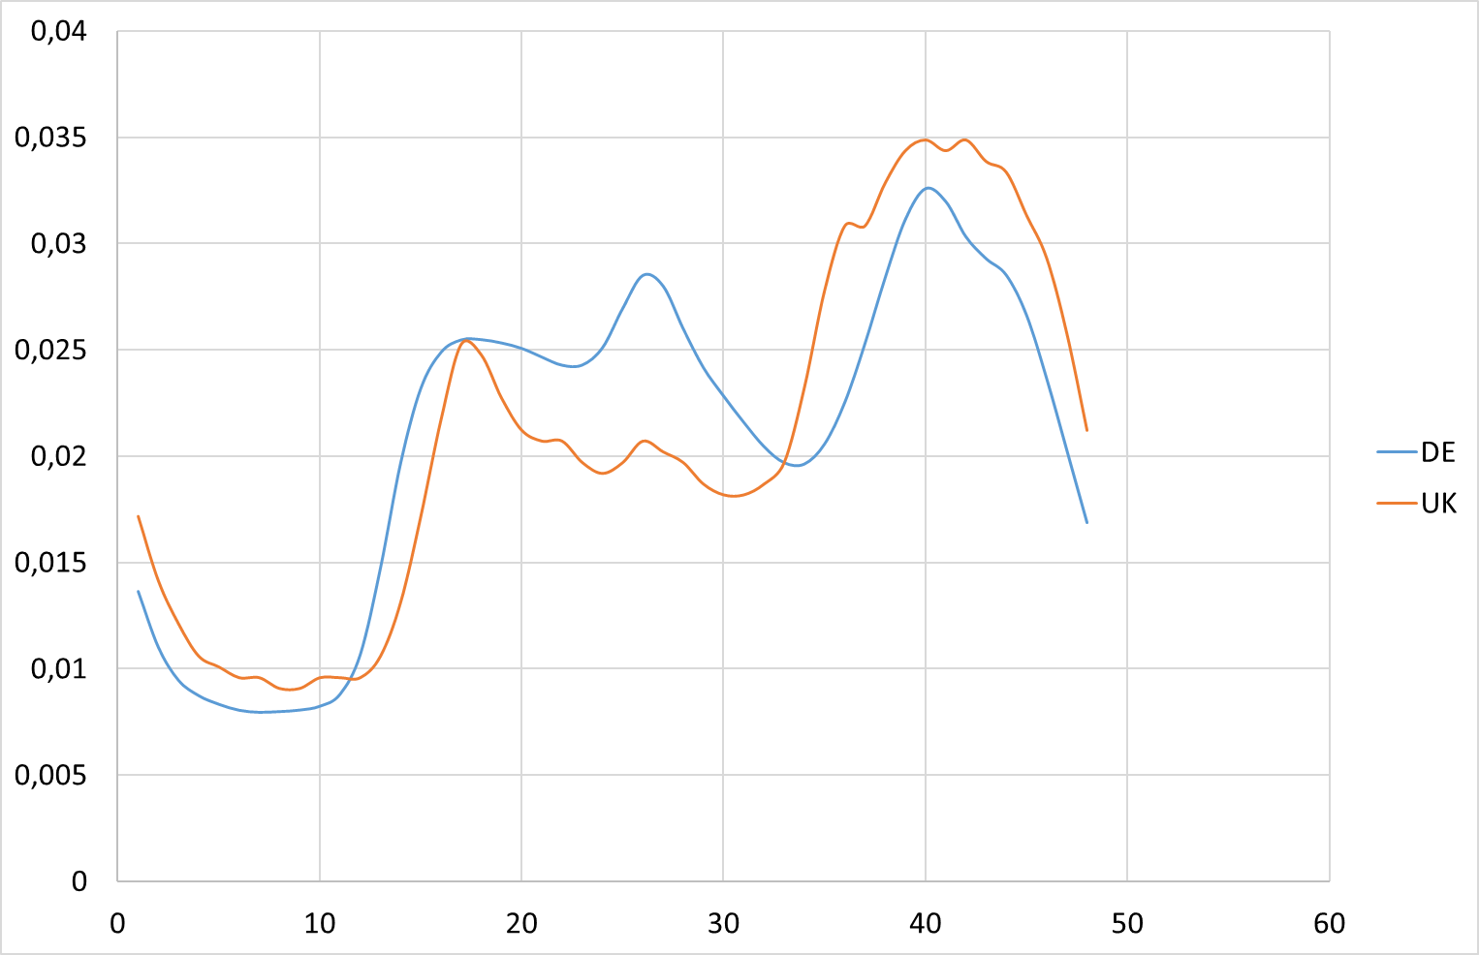

Introduction and motivation
Energy transition means the demand side is becoming more important
Flexibility: dynamic tariffs and/or capacity charges may be implemented
There is a lot of diversity between households, much of which is accounted for by socioeconomic variables
Several demand simulation tools based on Time Use Surveys available, but not all open source (e.g. UK CREST: Richardson et al. 2010, Germany Synpro: Fischer et al. 2015, Sweden: Widén & Wäckelgård 2010)
Objectives:
Extend CREST model to German context
How well can socioeconomic variables explain the diversity…
…and be employed in simulation models to reproduce it?
What about load profile characteristics, e.g. peak?
Exploring socioeconomic and temporal characteristics of British and German residential energy demand
Notes:
Max:
The comparison of the SLP for UK and GER is a good idea.
Then the question must be answered why it is important to identify the causes for the shape of the load profiles.
Identification of flexibility
Why is it important to know how different SD groups contribute to the SLP?
Capacity prices → discrimination of special SD groups?
Objective of this work:
Exlanation of SD and geographical differences of hh load profiles as a basis for policy recommendations for future electricity tariffs
Timur: “The shape is clearly different, but why? What does socio-economic variables can tells about it?” -> Objectives -> methodology

Slide 4
Socio-demographic impacts on energy and power demand
Household factors:
Total energy demand:
Income is associated with household energy use and carbon emission (e.g. Druckman et al. 2008, Craig et al. 2014).
Age and number of householder has a positive impact on energy demand (Jones et al. 2015, McLoughlin et al. 2013).
Couples with children are more likely to have a higher appliance-related carbon footprint than couples without children (Craig et al. 2014)
Dwellings with similar built vary in their annual electricity consumption (Firth et al. 2008)
Temporal factors:
Heating behaviour
Appliance ownership and frequency of use
Household size, income, working status and application of LCTs (Hayn et al. 2015)
Behaviour can account for over 50% of the variance in energy demand (Haldi et al. 2011).
Selected socio-demographic factors:
Family structure (includes age and number of children),
Income,
Household size,
Property Type,
Tenure.
Exploring socioeconomic and temporal characteristics of British and German residential energy demand
Notes:
WholeSEM in London

Slide 5
Metadata availability, from TUS and metered data
Variable | Low Carbon London | German Meter Data | In UKTUS data? | In GERTUS Data?
No of people | No of people | No of people | Adults, children, total in household. | No of people and children under 18
Employment | Work from home (yes/no)? | Employed and type of job |  | 6 cats including pensioner, no. of employed people
Household structure | Very many categories | 7 categories | 8 cats: single, married, w w/o kids, ”unclassified“ + “other” | 5 cats: single, pair no kids, single parent w/kids, pair w/kids, other
Age | For each individual | No in bands: 0-5, 6-17, 18+ | For each individual and in bands: 0-14, 0-16, 11-15, 16-19, 5-10. | Exact age in years, then 80-84, 85+
Type of building | Detached, semi, terrace (2), flat | 1-2 family, multi-family house | House/bungalow, flat, rooms, other, | Only floor area and no. of rooms
Electric heating | Yes/no | Yes/no | No information | No info
Rents/owns | Yes/no | Yes/no | Owns, Mortgage, Part rent, Private rent, social housing, rent free. | Rents/owns/free living
Income | Missing | 8 bands | Individual + 13 bands | Monthly income in 18 bands
Appliances | No of each appliance | Not present | No of each appliance | Computer number, car number, internet access y/n
Sex | No of people m/f | Not available | Each person | Each person
Exploring socioeconomic and temporal characteristics of British and German residential energy demand
Notes:
Max:

Slide 6
Methodology: overall approach
Time Use data
 | UK | DE
Time-use dataset | UKTUS 2014/15 | GTUS 2012/13
Standard load profiles | Elexon profiles | VDEW H₀ profiles
Smart meter data | Low Carbon London Trial | IZES Project/HfT Berlin
Load Profile Model (CREST)
Produce aggregated profiles
Produce differentiated profiles
Validate with Standard load Profiles
Validate with Smart Meter data
Exploring socioeconomic and temporal characteristics of British and German residential energy demand

Slide 7
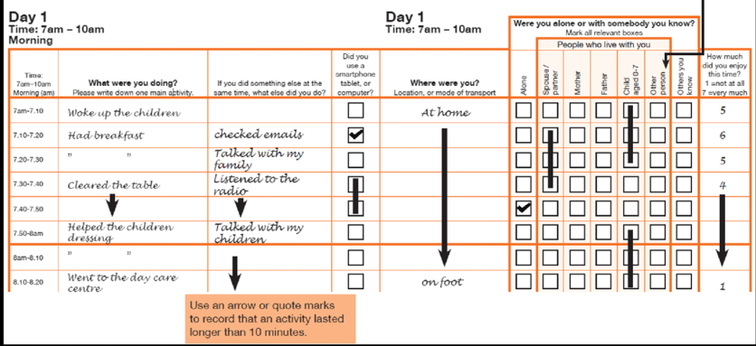
Method of deriving occupancy/activity profiles from TUS data
Exploring socioeconomic and temporal characteristics of British and German residential energy demand

Slide 8
Deriving Markov chains to produce load profiles: input for CREST model
Input for CREST model:
24 hour occupancy probabilities
Starting states
TPMs
Activity probability distibutions
Until now differentiated by no. of people, 1-5
No seasonal differences in occupancy
Richardson et al. 2010
Exploring socioeconomic and temporal characteristics of British and German residential energy demand

Slide 9
Results: lessons learned with 2 TUS datasets
 | UKTUS | GERTUS
Individuals | 10208 | 11000
Households | 4741 | 5000
Diary days | 16550 | 33000
Parallel activities | Up to 4 | Up to 2
Location of activity | Given | Given at start and end of day, otherwise implied
Location of household | County | Only East/West split
Weighting factors | Household, person, diary (day and individual), 7 day week | Household, individual, diary
Allocation of activities to 6 CREST categories | Manual based on original allocation from Richardson et al. (2010) and expert judgement
Although broadly similar, the two surveys have some key structural differences (e.g. no of diaries)
Exploring socioeconomic and temporal characteristics of British and German residential energy demand

Slide 10
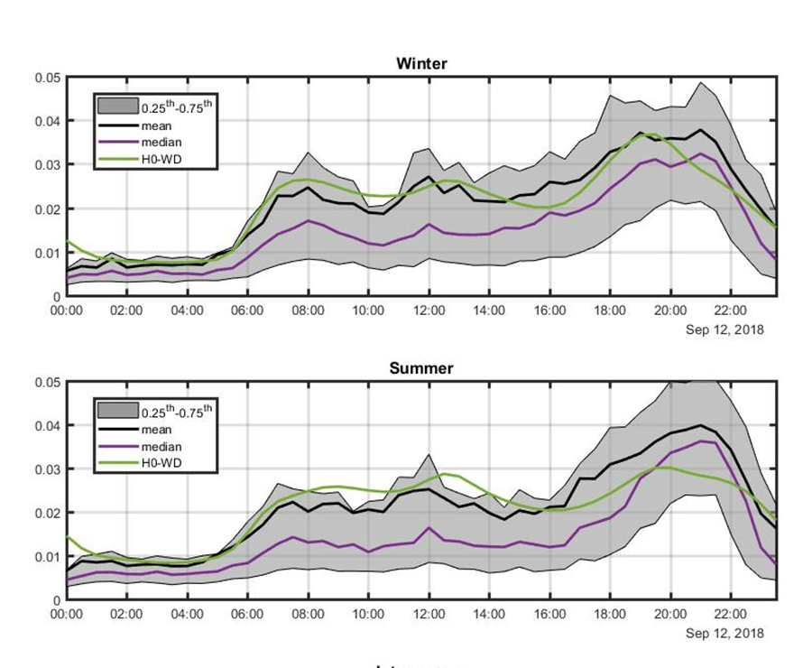
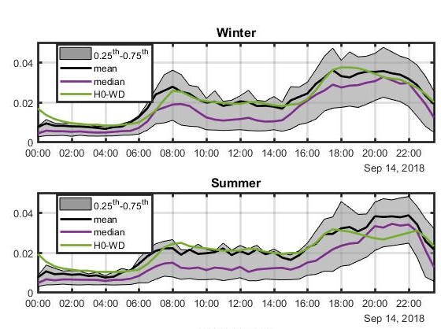
Results: synethetic vs. standard load profiles for whole population
Results show a good agreement with NRMSE for both countries and seasons
Seasonal effects are not considered in these figures
Summer evening peaks not well captured in CREST model – two peaks!
NRMSE 0.0999
NRMSE 0.0948
NRMSE 0.1365
NRMSE 0.1395
DE
UK
Exploring socioeconomic and temporal characteristics of British and German residential energy demand

Slide 11
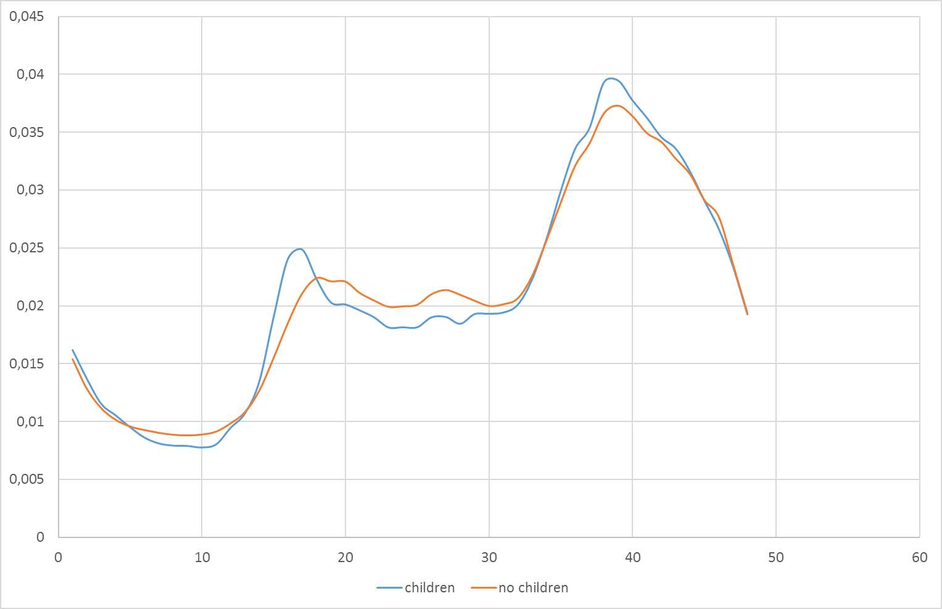
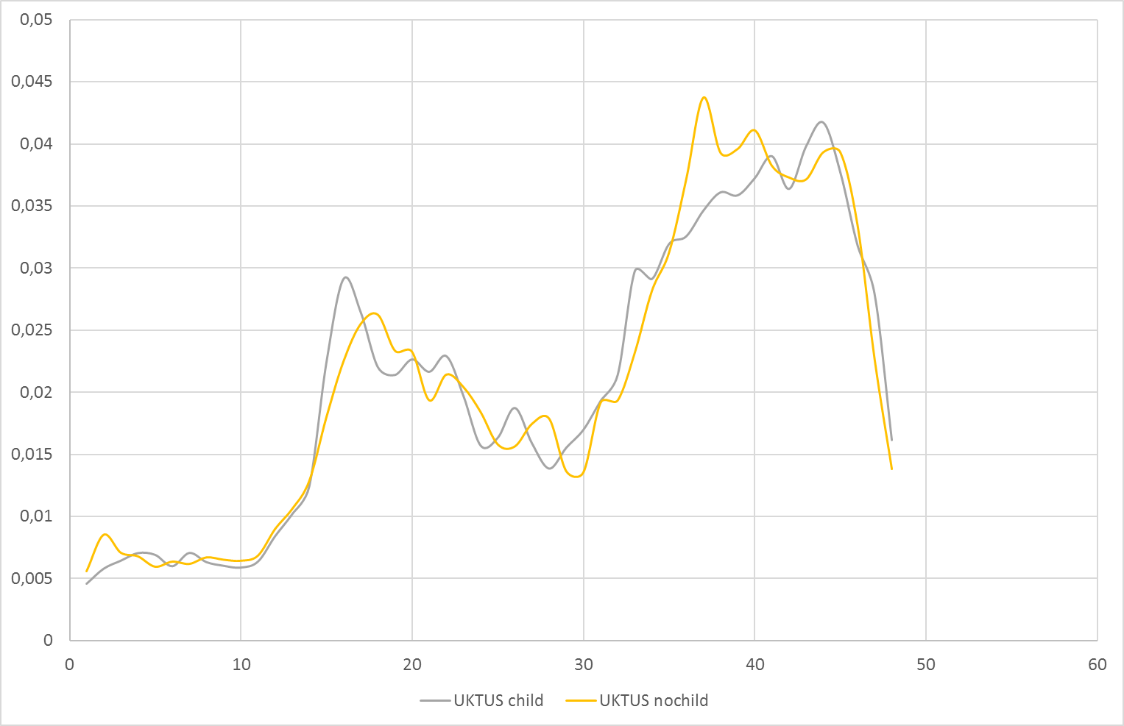
Results: (re-)producing profiles for socioeconomic groups
Presence of children on median profiles left LCL, right CREST, 150 households:
Higher morning and evening peaks in LCL data
Only morning peak is well reproduced in CREST
Exploring socioeconomic and temporal characteristics of British and German residential energy demand

Slide 12
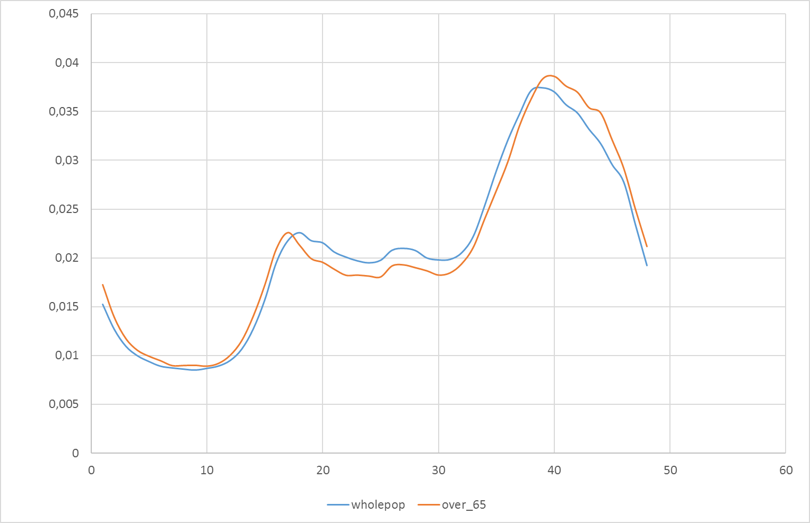
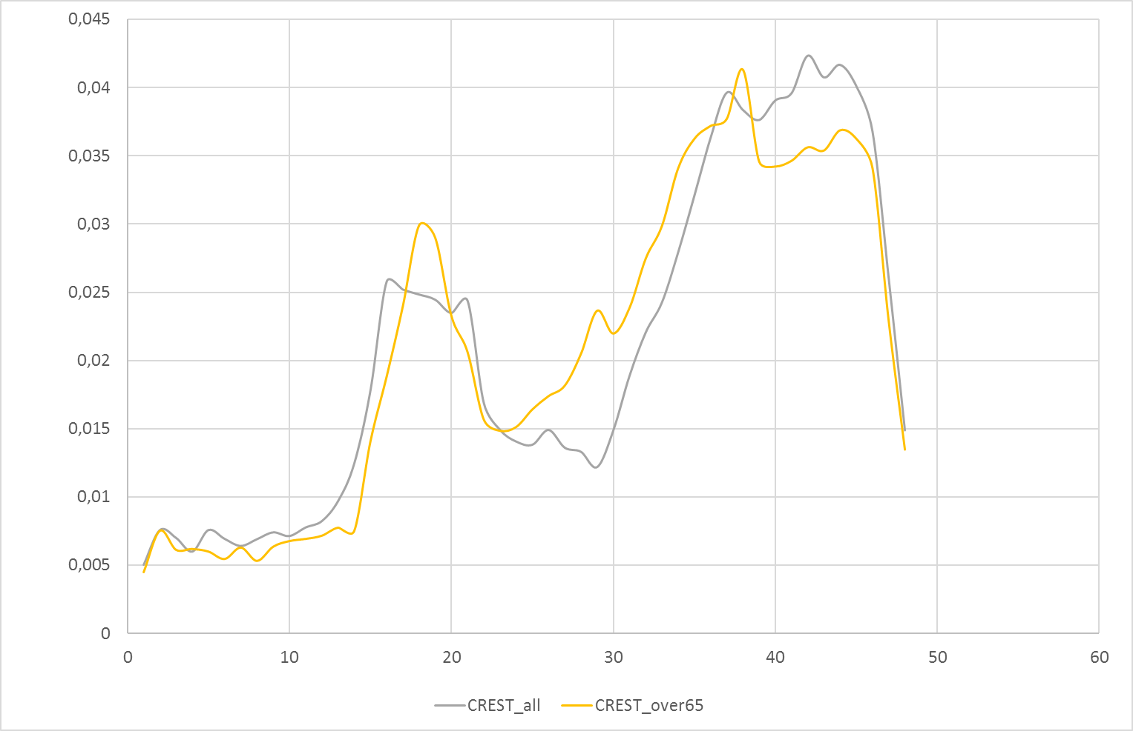
Results: (re-)producing profiles for socioeconomic groups
Presence of over 65s on median profiles left LCL, right CREST, 150 households:
Similar peaks but higher daytime demand in LCL data
CREST model shows higher morning peak for over 65s
Exploring socioeconomic and temporal characteristics of British and German residential energy demand

Slide 13
Results: comparing activities between Germany and the UK
Probability of >=1 active person undertaking one of these six activities
Stronger midday peak in DE, morning peak more pronounced in UK
Higher evening peak in DE, compared to flatter/broader one in UK
Strong similarities in evening TV watching habits
Exploring socioeconomic and temporal characteristics of British and German residential energy demand
Notes:
Timur: Is this weekend or weekday? Points for discussion: UK sharper morning peaks (especially cooking – English breakfast vs continental breakfast); Hot lunch at home for DE and eating out or sandwich for UK; more synchronised TV watching in DE and wider periods for evening meal cooking in UK, but both have sharp decrease in TV watching around similar time.
JT: High level of synchronisation in TV watching in Germany – other work points to low flexibility associated with high societal synchronisation (Torriti et al, 2015)

Slide 14
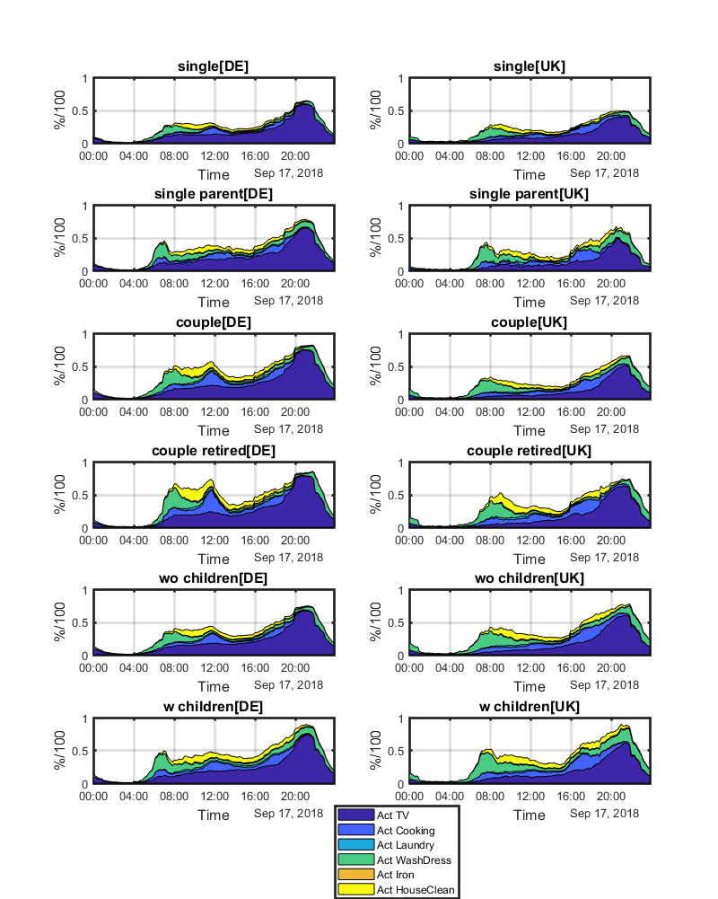
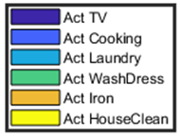
Results: comparing activities between Germany and the UK
Children more pronounced in DE, leading to higher morning peak
Young people couples have a broader evening peak
Both in UK and DE, single households tend to be less consistent
Evening peaks in UK are broader and gender-related (women occupancy from 4 PM increases significantly) along with presence of children
Exploring socioeconomic and temporal characteristics of British and German residential energy demand
Notes:
Timur: Good points. A couple of more: both in UK and DE single households tend to be less consistent (reinforces the concept of social-synchronisation); there seemed to be more midnight activity in UK for bigger households.

Slide 15
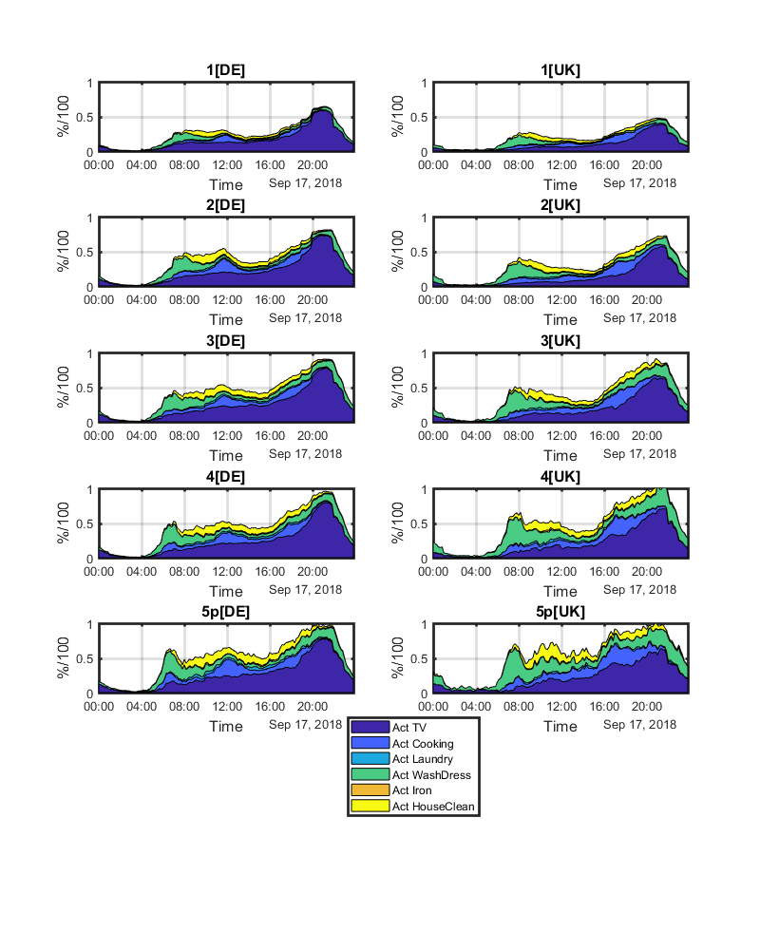
Results: comparing activities between Germany and the UK
No of residents leads to a higher morning peak, as expected
Little difference between income levels (not shown here): would seem to suggest that appliances / ownership are more important than activities per se
More peaky profiles with 5+ occupants due to small sample sizes
Exploring socioeconomic and temporal characteristics of British and German residential energy demand
Notes:
Timur: Good points. A couple of more: both in UK and DE single households tend to be less consistent (reinforces the concept of social-synchronisation); there seemed to be more midnight activity in UK for bigger households.

Slide 16
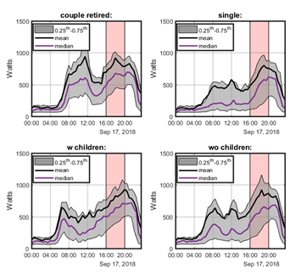
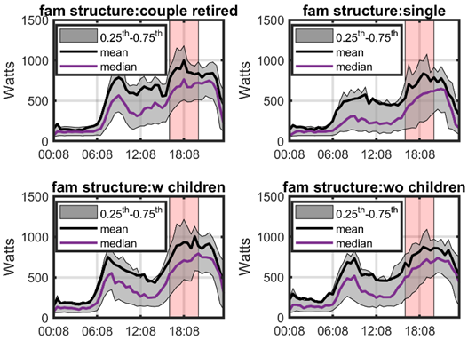
Results for the peak period
Flatter, broader peak for retired couples
Presence of children tends to heighten and broaden the evening peak for both countries
DE
UK
Exploring socioeconomic and temporal characteristics of British and German residential energy demand
Notes:
Timur: Perhaps reiterate some of the points from previous two slides aligning with the SLPs. Also mention the probability of TV watching vs the power consumption of the TVs.

Slide 17
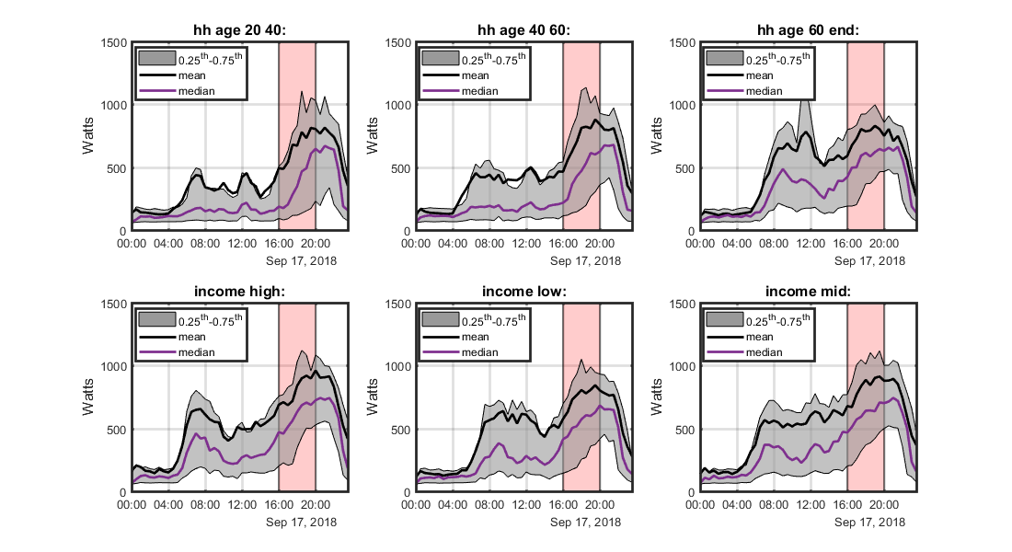
Results for the peak period: income in DE
Little/no discernable effect on profiles
But the only differences between these households is their activities/occupancy
The presumed dependency on appliance stock is not captured here.
DE
Exploring socioeconomic and temporal characteristics of British and German residential energy demand
Notes:
Timur: Perhaps reiterate some of the points from previous two slides aligning with the SLPs. Also mention the probability of TV watching vs the power consumption of the TVs.

Slide 18
Discussion
Time Use Data:
Some issues with parallel activities in TUS as well as locations unclear (DE)
Issue of small sample sizes for some household types as well as large inner-sample variance – should consider sample sizes for results
CREST Model:
Seasonality not (yet) well considered in approach
Problem of the six/seven groups of activities in CREST
Night-time profile shape as fundamental issue
Flexibility of load profiles depends on appliances, so perhaps need different allocation of activities
Appliances not updated for DE: where to get data for this?
Model not well reproducing empirical profiles, e.g. due to appliance stock, building etc.
Smart meter data:
Regional differences between habits and use of LCL
London sample, urban, wealthy etc.
Exploring socioeconomic and temporal characteristics of British and German residential energy demand
Notes:
Timur: Slide 12: discussion on points of consideration in the methodology and interpretation of results
Good points, yes, plus the regional differences between LCL, SLP and CREST output from UKTUS.

Slide 19
Conclusion and outlook
There are some clear differences between groups and countries, revealed by empirical data
The differences between the two countries are a reminder of the importance of non-energy policy (e.g. school hours) in determining peaks
These differences have implications for dynamic tariff and/or capacity charging
Extended CREST model to German context, but missing appliance stock
The CREST (or similar) model can be reliably employed for ‘typical’ households but is less robust for socioeconomic groups
Extensions should focus on (for discussion)
Sharpening the specification of socioeconomic subgroups to include appliances etc.
The quantification of qualitative trends explored, e.g. by using load indicators like mean daily peak, time and extent of peak etc.
Regional effects and differences, where data allows
Appliance level profiles between the countries
Exploring socioeconomic and temporal characteristics of British and German residential energy demand
Notes:
Timur: Why not income? Regional differences in demand could require different ToUs depending the objective of ToU (nationally vs locally). Consideration of individual appliance usage between countries.

Slide 20

Thank you for your attention!
Thanks also to the Demand Centre for partly
funding this research.
Exploring socioeconomic and temporal characteristics of British and German residential energy demand

Slide 21
Background and previous research
Socioeconomic characteristics of households and dwellings have important implications for power (kW) and energy (kWh) demand
Much work carried out in recent years on “domestic/residential load profiles” (> 100 papers):
Clustering and regression of residential power profiles and demand is common
Datasets:
Much of this work uses the Irish CER dataset
The EFUS dataset has mainly been used to analyse internal temperatures and heating behaviour
LCL dataset not yet fully exploited?
Gaps for heating and building approaches, but this is challenging due to a lack of metadata on the building characteristics

Slide 23
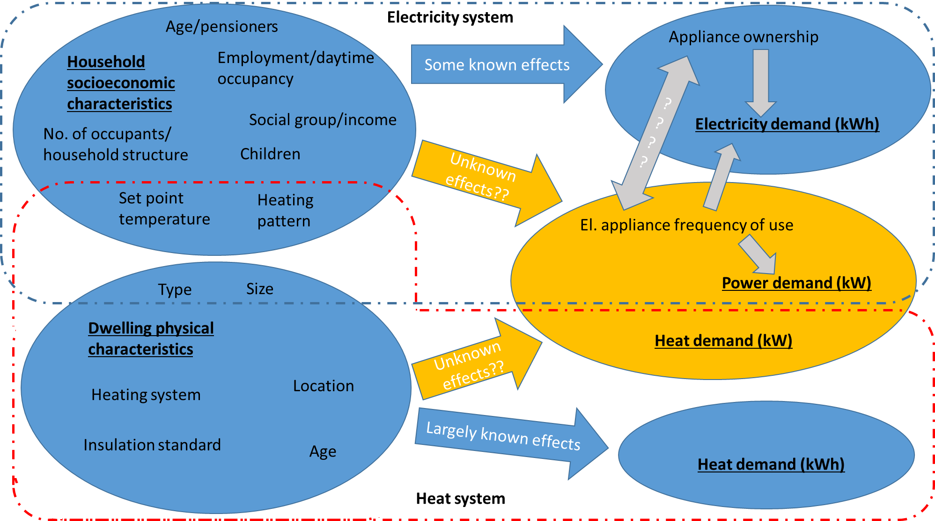
Overview of (some) dependencies

Slide 24
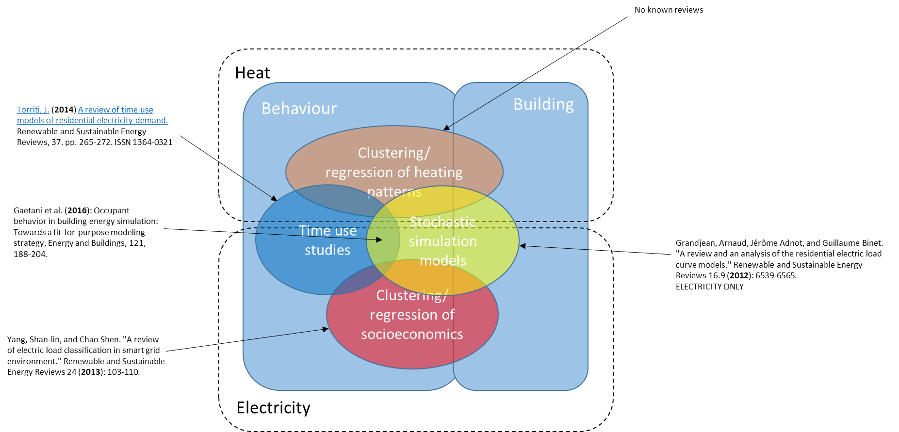
Idea 1: review paper
Still worthwhile exploring this direction
Notes:
Most gaps for clustering and regression/classification approaches, esp. Since 2013

Slide 25
Idea 2: clustering/regression of heat/electricity
“Original idea” but adapted to explore the link(s) between heat and electricity use
Gain better insights into e.g. electric heating
Utilize the 10s time resolution of the EFUS dataset
Employ gas and electricity meter readings of Irish CER dataset
LCL dataset contains a field “daily newspaper”: explore connections with energy use
Output: clusters or regression models of households according to electricity and heat demand
Interesting area of research, but challenging to develop highly explanatory models (e.g. R² of regressions of 0.2 to 0.4)

Slide 26
Idea 3: time-use data
Comparative study for UK (2014/15) and Germany (2011/12)
Use time-use data to derive transition probability matrices (TPMs)
TPMs form the basis of stochastic (multi-)energy simulation models:
Update CREST for UK?
Transfer CHAP (CREST HEAT AND POWER) model to German context

Slide 27
Idea 3: time-use data
Motivation:
flexibility needed, peak is important, TOU tariffs will be introduced
Utilities must target toward specific sociodemographic customer groups
Research questions:
What are the „typical“ load profiles of different sociodemographic groups?
How reliably can these profiles be derived from TU data?
Methodology:
Derive load profiles for different sociodemographic groups based on TU and valuate these with smart meter data

Slide 28
Idea 3: preliminary results

Slide 29
Idea 3: preliminary results: no of people
UK:
TU 2000 from CREST model
Or updated based on TU2014/1015
DE: TU
UK: LCL Metered
DE: Metered

Slide 30
Discussion
Ben:
How does behaviour transition in the future and how to model?
How to model „shocks“ like decision for an electric vehicle?
Stefan (meeting next week):
PhD student worked on heat emissons in cities
UKRED(?) project on distribution across dist. grids (Stefan)
Regionalisation: does the data allow a differentiation by location? Check
Curve with UK cooking: check data as too volatile in morning
Variables:
Slide 5: building and behaviour are correlated? Yes, in fact evidence that the type (and not just size) of building effects demand profile
Age: differentiate 0-5 and 6-18 as behaviour different, also 65+ for pensioners
Gender, employment, family different to group of students
CLNR check this for distinction between renter and non-renter (data available)
Peak not important – question of equity, penalising people etc.
Batteries in Bracknell project with DN data (Timur to send link)

