Slide 1

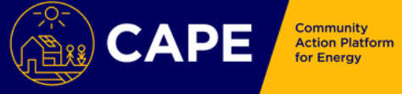
Community Energy: A new democratised energy system?
Dr Helen Roby and Professor Sally Dibb

Slide 2
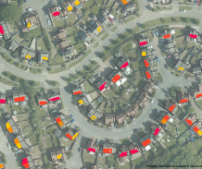
What is CAPE?
Community Action Platform for Energy (CAPE), funded by InnovateUK, is an interactive website to help communities build and run community energy projects.
Gives users access to satellite, building, social and demographic data to help understand the benefits of running particular energy projects.
Gives access to local suppliers and to other resources such as details about funding and legal advice.
Partners on the project include the SatApps Catapult, Tech Mahindra, SmartKlub, MK Council and Community Action MK. https://capeproject.co.uk/

Slide 3
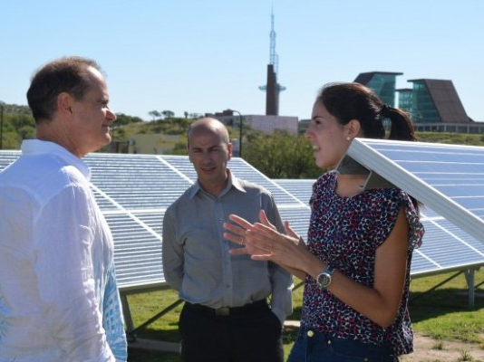
Methods
Semi-structured key informant interviews, recorded and transcribed for analysis in Nvivo.
Contribution
  Defining community energy as communities see it
  Impact of contextual factors on the development of projects
16 Key informants from a range of areas
  Academics researching in this area
  Local councils
  Community energy groups
  Women’s Institute
  National Energy Foundation
  Landlords

Slide 4

Why is community energy important?
Key part of the UK Government’s plan for decarbonising the energy sector, by it producing between 0.5GW (2.2%) and 3GW (14%) of installed energy by 2020 (Department of Energy and Climate Change, 2014).
Locally led, bottom-up way to tackle climate change
Empowers the community (Bomberg and McEwen, 2012)
Engages individuals in sustainability that could lead to wider behaviour change (Hoffman and High-Pippert, 2010)

Slide 5
What does community energy mean?
What is a community?
  Geographical based (Walker and
  Devine-Wright, 2010)
Based on a shared goal or interest
Based on community benefit
Based on a locally led project
(Walker and Devine-Wright, 2008)
‘…the most successful things, but they are very much based in the community, but that seems to be the most successful place to start things because if you can get a community interested then things start happening, whereas if you try and put it in top-down people are disappointed and they don’t know what to do with things’ (Su, Women’s Institute)

Slide 6
Non-material motivations for community energy
‘…what we found is that often it came down to charismatic and persistent individuals to some extent’ (Tom, Academic).
Passion of the champion
Community identity and cohesion
Uniting behind a common goal
Empowerment
‘You know, a lot of them have got a problem with condensation, a lot of them have got a problem with insulation, so they’ve got high heating bills. So, they’re a relatively easy group to go to, and say, look we’ve got some potential solutions’ (Superhomes owner)
‘There is something about Community ownership but I think it is really important, community empowerment in a sense, that certainly they’re taking some control and responsibility for production of energy’ (Superhomes owner).

Slide 7
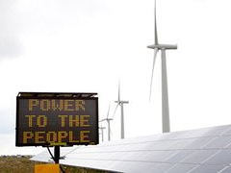
Democratisation
Decentralisation
Digitisation
Decarbonisation

Slide 8
What is meant by decentralisation?
Energy production that moves away from large, centralised power plants to distributed generation, sometimes known as small scale, embedded or decentralised generation, where energy production and conversion units are situated close to the customers (Alanne and Saari 2006).

Slide 9
What is meant by democratisation?
Democratisation facilitates the shift of regulation from producers to consumers as their choice increases and becomes more localised (Tomain 2015).
‘Okay, we have a number of sources of revenue. So we are getting an income. Those sources are people paying their bills, yes? So we’ve got solar... So we chuck solar panels on a roof, the people underneath...So there’s no capital outlay for that business. But they pay for their energy. They pay a better rate than they’d pay to any of the big six, but they’re still paying. So we invoice them monthly for their energy. We are EON, but we’re lovely. We’re nothing like EON’ (Director, Community Energy Group).

Slide 10
New business models
New roles for consumers
Changing incentives
‘If I was to say you should put a battery in your house because it’s going to help stabilise the grid, people would say, well actually that’s a reason not to do it because I hate the people... You know, I hate the fat cat that’s going to be making all the money, you know? So as much as people in the solar industry, you know, thousands of people realising that actually the grid needs help’ (Manager, Solar PV Installer).
‘If you go east/west, in a home particularly, you’re generating when you get up in the morning and when they’re home in the evening, you know, you still generate through lunchtime as well, but your main generation, your curve is a lot lower, a lot less steep, and a lot more of that will get used’ (Manager, Solar PV Installer)

Slide 11
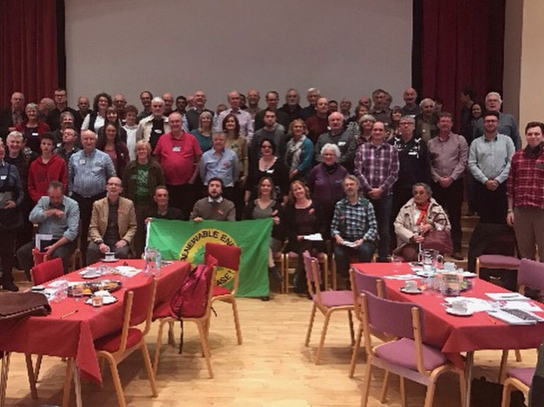
Energy as a vehicle for change
‘Energy is often, or energy and climate change certainly, are often a useful kind of vehicle by which they can do other things, if you like….They often were, more than anything, were looking to improve their local community in some way, shape or form, and energy became a useful vehicle for at a certain point in time to allow them to do that, you see what I mean?’ (Tom, Academic)

Slide 12

Conclusions
Early stages of analysis
Community energy could be vital in a shift to low carbon energy.
Consumer engagement with the energy system will change
Community energy can be a catalyst or vehicle to bring about wider change to more sustainable practices.
Community energy has the potential to power and empower communities

Slide 13
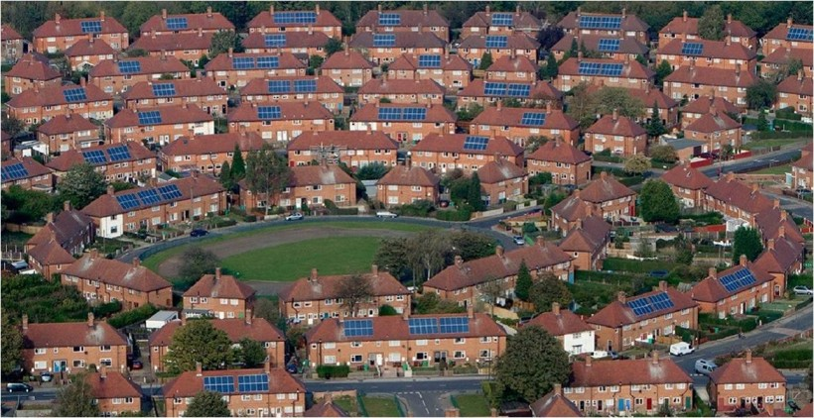
Thank you
Any Questions?

