Slide 1

The use of consumer data to optimize smart grids for electricity and district heating
Carl Dalhammar, Lund University
Andrea Hjärne, City of Malmö
Smart Cities Accelerator

Slide 2
Content
Law as an enabler or barrier for new local energy solutions
District heating in Sweden
The need for data for optimizing grids, and privacy concerns
Objective and methods
Main results
Need for further research

Slide 3
Background: law as a barrier for new energy solutions
The local level is of increasing importance in climate governance
Smart grids, waste-to-biogas, city planning, energy storage, low temperature district heating, solar PV solutions, energy-efficient renovations, integrated water and power solutions, heat pumps
Many energy solutions at the local level faces legal and administrative barriers
Need to identify, analyze barriers, and propose changes in legal frameworks

Slide 4
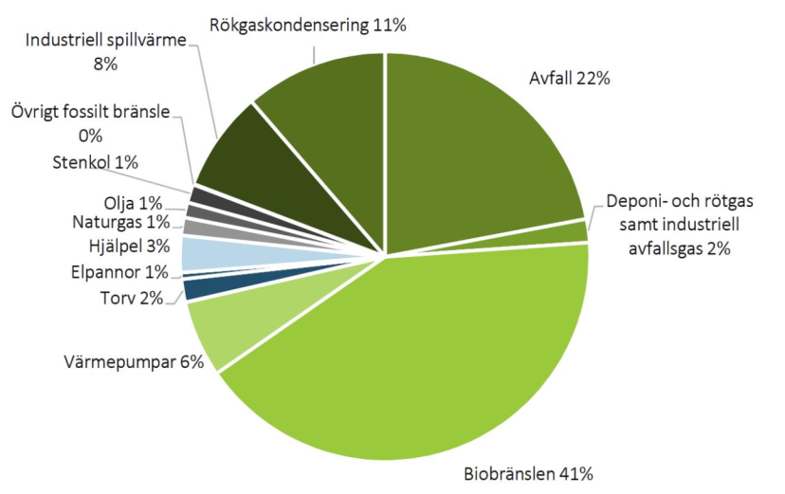
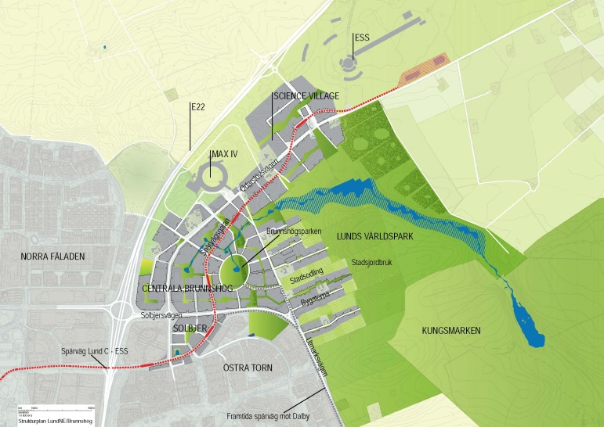
District heating in Sweden
Large share of district heating in urban areas
Biofuels and waste are the main fuels
Investements in new, low-temperature district heating grids
Plans to lower temperatures in existing district heating grids
Projects aiming to integrate grids for electricity, district heating and cooling, and buildings – balance energy loads and increase flexibility!

Slide 5
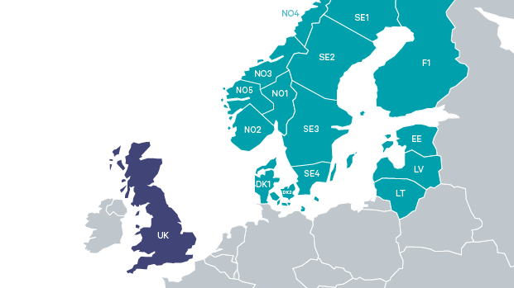
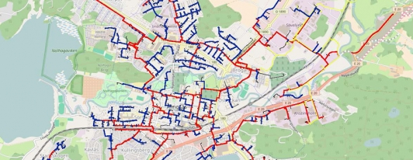
Need for data
Electricity grid
Heating grid
Use patterns, temperature + location
Buildings, weather forecasts etc.
Concerns:
Consumer privacy
GDPR & national rules

Slide 6
Objective and methods
Aim: provide an analysis of the legal issues related to consumer data collection, storage, and usage in electricity and district heating grids
Focusing on consumer privacy
Differences between heating and electricity grids
Methods: literature review, legal analysis, focus group discussion at a DSO, interviews with two experts on IT law

Slide 7
District heating data
Less intrusive than electricity data
Not sensitive for multi dwelling buildings
Sensitive for single dwelling buildings
” With increased resolution, it would be possible to see showers or even single hot water taps. This would certainly be a risk for trespass of personal integrity. High-resolution measurements could be of interest not only to take energy efficiency measures but for other purposes as well. Information about customers’ use of domestic hot water could perhaps be of interest for companies selling shampoo, while information about hours people are away from their homes could be of interest to companies that sell security systems, or for burglars!” (Gadd 2014)

Slide 8
Rules on privacy of user data
General Data Protection Regulation (GDPR)
Harmonized rules on data collection, handling and use
Greyzone: Consumer law, marketing law, and contract law
National rules on public access to official records
In Sweden: for DSOs owned by municipalities, most data is considered to be public access
National rules on data, granularity, statistics, time lags etc.

Slide 9
GDPR, some main issues I
Art. 5: ‘Data shall be collected for specified, explicit and legitimate purposes’; ‘Data collection shall be limited to what is necessary in relation to the purposes for which they are processed (‘data minimisation’)’
Art.6 : ‘Processing shall be lawful… [if]…processing is necessary for the performance of a contract to which the data subject is party … [or]…processing is necessary for the performance of a task carried out in the public interest…’

Slide 10
GDPR, some main issues II
Art 4, definitions: ‘pseudonymisation’ means the processing of personal data in such a manner that the personal data can no longer be attributed to a specific data subject without the use of additional information…’
Relevant especially when external organizations process the data
Art. 12: ‘…information should be provided …in a concise, transparent, intelligible and easily accessible form, using clear and plain language…”.
Inform about planned use, not potential future use!
Short and concise information!

Slide 11
Conclusions and further research
If the future vision is to deliver energy just in time, while integrating various different energy grids and optimize the system(s), simultaneously managing to deal with huge amounts of personal data in an appropriate manner, many things need to be sorted out…
Privacy: Need to consider EU rules and national rules
Future research:
Data management solutions in integrated grids
Data on buildings, e.g. storage capacity, heat exchangers; ownership
Data in micro grids, off-grids and other emerging solutions

Slide 12
Tack!

