Slide 1

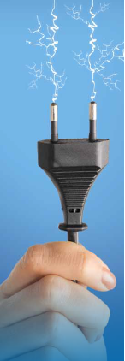
Actively aware
Passively engaged
Integrating prosumers into the electricity grid: the interplays between technology and people
Yael Parag
School of Sustainability
Interdisciplinary Centre, Herzliya, Israel
BIEE conference: Consumers at the Heart of the Energy System?
18-19 September, Oxford

Slide 2
Prosuming Services
Microgeneration => Kilowatts
Demand reduction => Negawatts
Demand response => Flexiwatts
Storage => Storewatts
Consumers => Prosumers

Slide 3
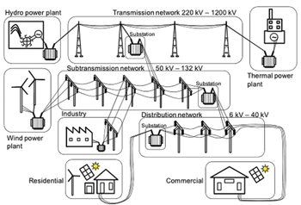
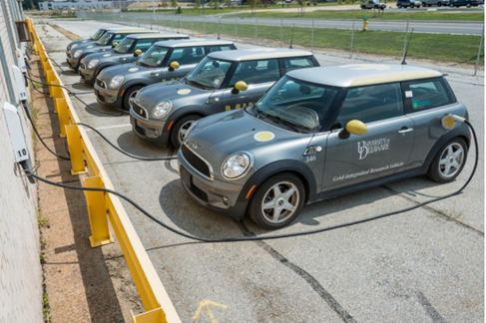
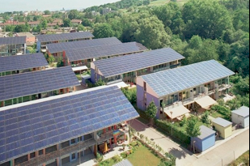
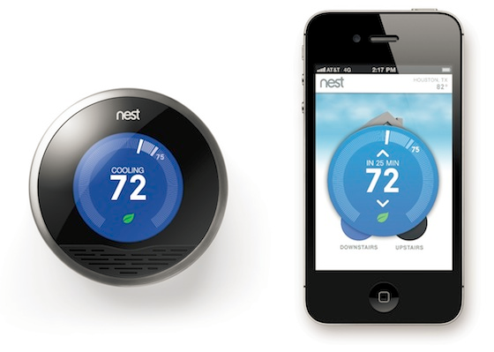


Kilowatts:
FiT for generation
Net metering
Storewatts:
FiT for storage?
Negawatts:
FiT for Negawatts?
Flexiwatts:
DR programs
Peer to grid/microgrid
Notes:
http://www.greencarreports.com/news/1094990_delaware-vehicle-to-grid-test-lets-electric-cars-sell-power
So essentially consumers are becoming prosumers of various services to the energy system, and demand reduction is only one of them.
Most common engagement policies for generation are FiT which are changing now to Net metering.
It is reasonable to assume that soon we will have FiT for storage services.
It is not easy to provide platform for energy saving (FiT for energy saving).
All the platforms so far are scattered.

Slide 4
Peer 2 Peer
Notes:
http://www.greencarreports.com/news/1094990_delaware-vehicle-to-grid-test-lets-electric-cars-sell-power

Slide 5
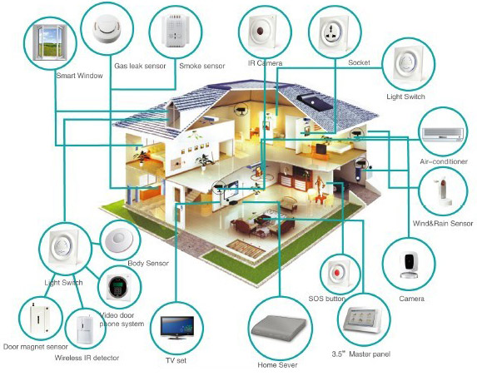
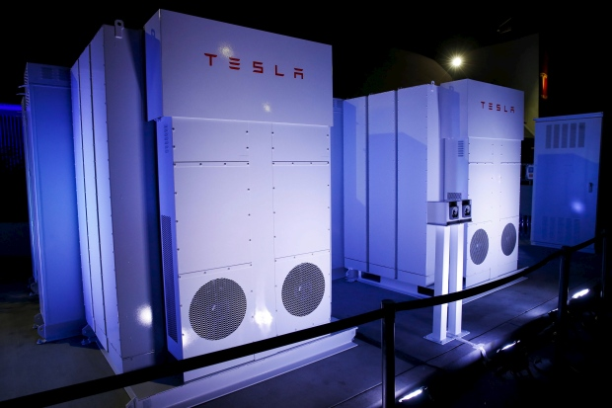
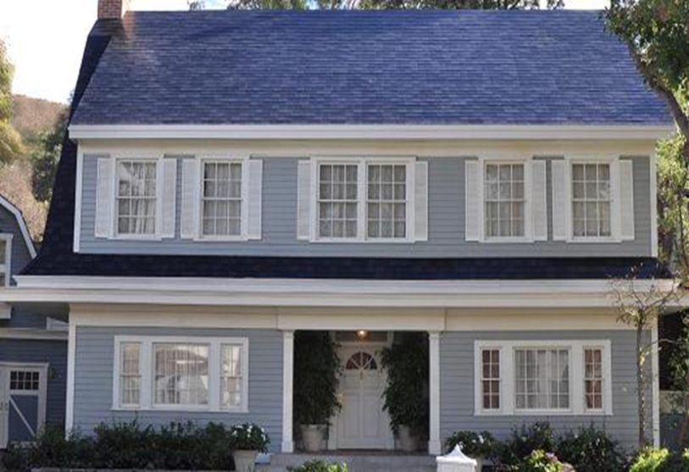
Grid & Load Defection

Slide 6
How could prosumers best be engaged in the energy system?

Slide 7
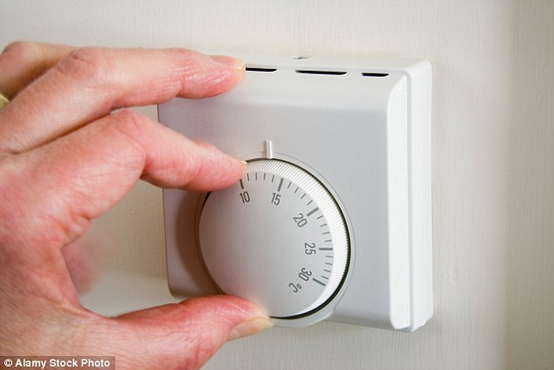
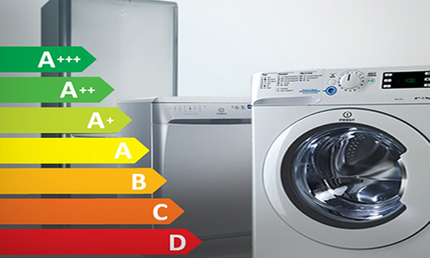
Negawatts
Behavioral
Technology
Flexiwatts
Storewatts
Kilowatts
Notes:
חסמים שונים להתייעלות ושימור כאשר מדובר בטכנולוגיה ובהתנהגות
אני רולה צהציג בתחילה איזושהי סכימה לניתוח ולהראות כמה ממצאים שקשורים בשימוש בה.
זה חלק ממסגרת ניתוחית שאני עובדת עליה שנקראת שינוי מהאמצע כלפי חוץ וטלי זוהר, שיושבת כאן, עושה בה שימוש בדוקטורט.

Slide 8
Awareness Vs. Seamlessness
Raising awareness, educating consumers, improving visibility, promoting pro-environmental values - insufficient for prosuming
Seamless technologies – technologies that are nearly invisible to customers or affect them only minimally.
Technologies that make the provisioning of prosuming services as fully automated, effortless and unnoticed as possible
  Smart home energy management systems
  Smart appliances (e.g., IoT).
Continuous interaction between prosumers and the electricity grid and an ongoing reshaping of demand and supply profiles
What may impact the uptake of seamless technologies?

Slide 9
Insights Based on the Following Studies
A study of an Israeli rural community (N=68) in which an electricity saving campaign was accompanied by a household electricity metering between June-September 2013. Consumption was compared to that of the same period in previous years (2012 & 2011) (Parag, Zur et al. 2017).
A national survey (N=509) of Israelis about perceptions of, and attitudes toward providing prosuming services to the electricity grid (in particular demand reduction, demand response and storage in electric vehicles) (Michaels and Parag 2016).
A national survey (N=554) of the Israeli non-technophobic population about interest in automated demand response in the smart home environment (Parag and Butbul 2018).
A national survey (N=452) of large Israeli households (4+) that explored the interest in subscribing to Time of Use (ToU) tariffs as a function of the mode of presentation (framing), the discount rate, the perceived demand flexibility and environmental values. (Parag, in preparation).
An ongoing research project aiming to reduce summer peak demand via tailored individual nudges and community interventions in two Israeli rural communities (N=350). In this project electricity consumption is monitored via smart meters.
An ongoing Horizon2020 funded project (N=43) aiming to reduce household electricity consumption using innovative smart communication in France and Austria (http://www.inbetween-project.eu/ ).

Slide 10
User-Centric Technology
Engagement schemes and engagement-enabling technologies need to be (and equally important - be perceived as) 'user-centric’
  ease of use and friendly user interface
  users need to see how the scheme or technology serves primarily their own interest
'Own interest’
  Saving money
  Saving time
  Reducing hassle and improving comfort
  Social desirability (doing the 'right thing’)
  Altruistic goals (saving the environment)

Slide 11
Awareness
Most of the users in the studies:
  Interested in saving energy
  Understand many of the economic, environmental and energy security benefits of saving energy and shifting demand
  Not interested in frequent engagement
  Welcome automation
Visibility and awareness are not necessarily perceived as promoters of energy related behavior change, and, over a long period, frequent nudges are likely to be ignored or even counterproductive

Slide 12
Effort
Effort | Action | Cost
high | Turn off TV* | No cost
high | Turn off lights*
high | Turn off computer*
high | Close windows when AC on
medium-high | Set thermostat*
medium-high | Set timer for electric boiler
low | Switch to efficient lightbulbs | Low cost
low | Buy efficient AC* | High cost
low | Buy efficient fridge*
low | Buy efficient dishwasher*
low | Install double glazing window*
 |  | Economic cost
 |  | No cost | High
Effort (level of engagement) | High (frequent) | Capability greater than willingness
 | Low (one time) |  | Willingness greater that capability
*sig differences between willingness to act and capability to act
Notes:
במחקר שערכו סטודנטים לתואר שני בחיפה בהנחייתי והנחיית תמר טרופ בחנו נכונות ויכולת לבצע פעולות בתחום שימור והתייעלות בקיבוץ עין חרוד.
אני מביאה רק נתונים ספורים משם. המשתתפים שצריכת החשמל שלהם נוטרה, התבקשו לענות על שאלון לגבי היכולת שלהם לערוך שינויים במספר תחומים לבין הרצון שלהם לעשות את השינויים.
הבחנו בין פעולות שהן ללא עלות ובין פעולות שהן ללא מאמץ. למשל, החלפת מקרר אינה דורשת שינוי התנהגותי – זו פעילות חד פעמית שיכולה להביא לחסכון גדול. לעומת זאת כיבוי ׳צריכת הרפאים׳ היא ללא כל עלות אבל דורשת יותר פעולות.
מה שראינו הוא שכאשר רמת המעורבות גדולה (התערבות יומיות או תכופה) היכולת גבוה מהרצון – כלומר הם יכולים אבל לא רוצים ואילו כאשר מדובר בעלות יקרה ומאמץ נמוך ההפך הוא הנכון.
הפתרון הנגזר מכאן לדעתי הוא אוטומציה.

Slide 13
Trust in institutions to run DSM

Slide 14
Trust in the Technology
Concerns regarding smart meters

Slide 15
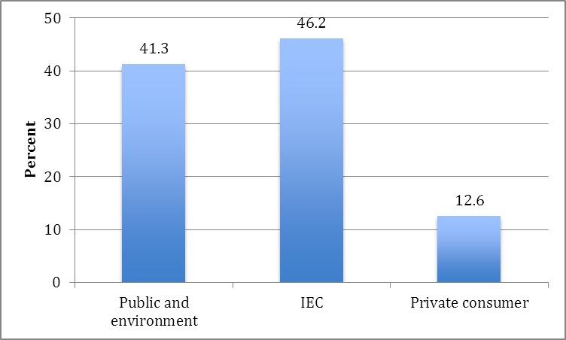
Who would benefit from DSM?

Slide 16
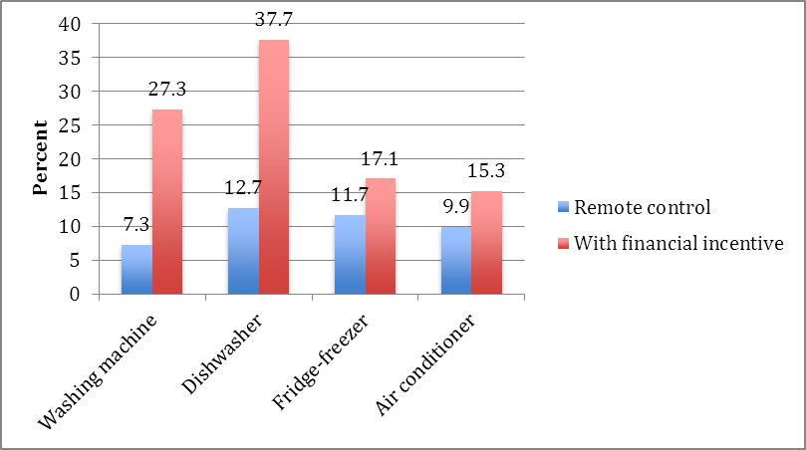
Financial incentives
Allowing a third party to manage Flexiwatts

Slide 17
Willingness to allow the smart home to manage Flexiwatts

Slide 18
Allowing a third party to manage Storewatts
Notes:
Willingness to allow the grid to access electricity stored in an EV battery

Slide 19
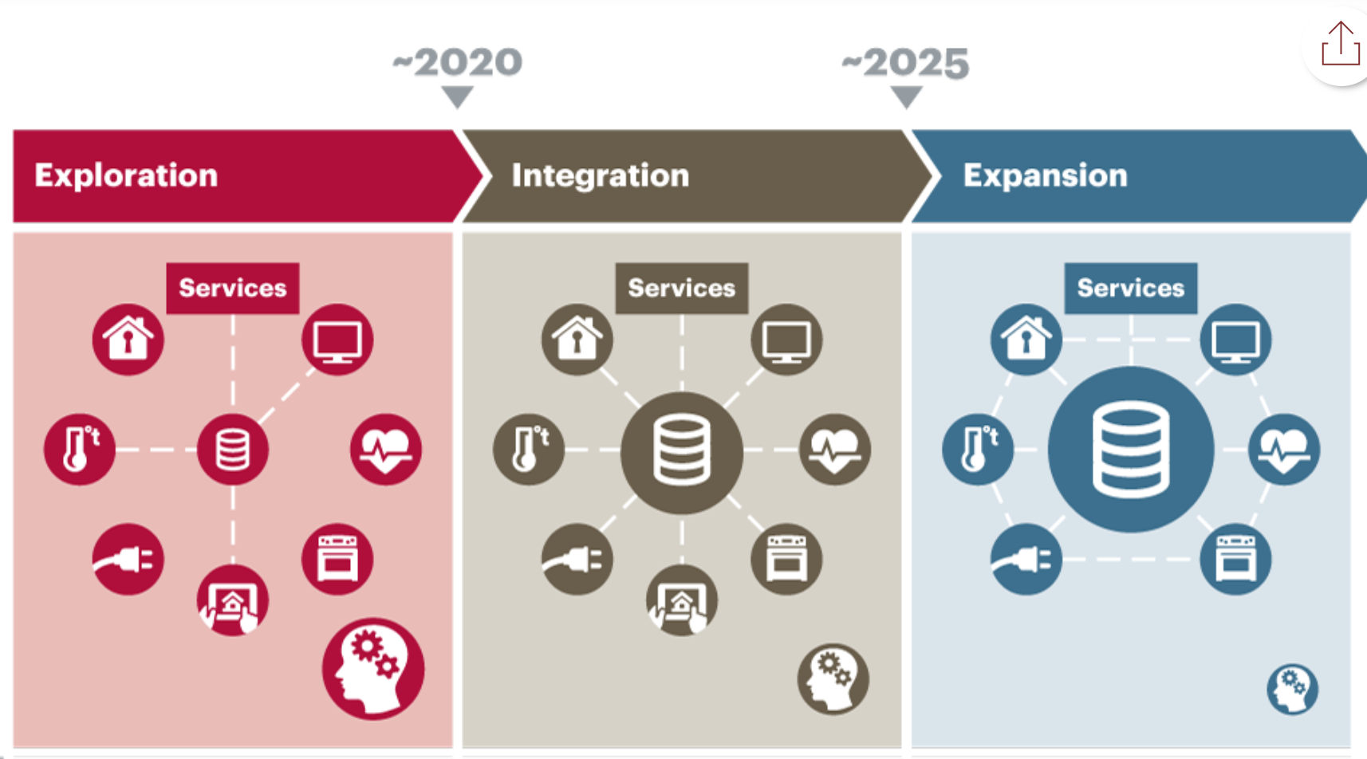
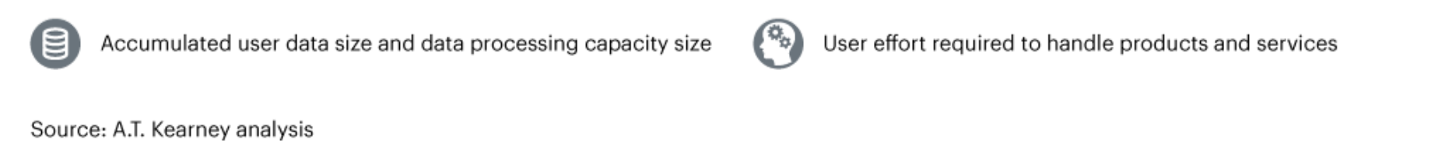
https://www.atkearney.com/communications-media-technology/article?/a/the-battle-for-smart-home-open-to-all

Slide 20
Smart Home Technology
Perceived as user-centric
Interests are aligned primarily with the prosumer
  The main beneficiary is the user
Effortless and seamless
Risk of data sold is acknowledged but not a barrier
Allows prosumers to effortlessly do the ‘right thing’
Periodic reports summarizing what was done, in order to keep prosumers actively aware while passively engaged

Slide 21
Smarthouse
https://www.youtube.com/watch?v=sgJLpuprQp8

Slide 22
Thank you for listening
yparag@idc.ac.il
Yael.parag@gmail.com

